Slide 1


INDIAN ACCOUNTING STANDARD-20 : ACCOUNTING FOR GOVERNMENT GRANTS.
BY UTSAV PALAN.

Slide 2
Points to be covered under IND AS-20 are as follows:
Introduction.
Scope.
Definitions.
Recognition of Government Grant.
Accounting Of Government Grant.
Disclosures.

Slide 3
INTRODUCTION TO IND AS-20
Why Government gives Grants?
The government gives grants to entities for various purposes including for industrial, geographic and social development to facilitate the flow of foreign investments and to promote entrepreneurship as subsidies to reduce the prices of goods and services offered by these entities.
Why IND AS-20 is Required?
IND AS-20 is required for the appropriate treatment of the Government Grants in the books of accounts and proper disclosures in financial statement. It also facilitates comparison with other entities and with prior periods and to give true and fair results to the stakeholders of the Reporting Entity.
This Photo by Unknown Author is licensed under CC BY-NC-ND

Slide 4
Scope
Applicability
Non-Applicability
Accounting and disclosure of government grants and
Disclosure of other forms of government assistance.
The special problems arising in accounting for government grants in financial statements reflecting the effects of changing prices or in supplementary information of a similar nature.
Government assistance that is provided for an entity in the form of benefits that are available in determining taxable profit or tax loss, or are determined or limited on the basis of income tax liability. For eg:-benefit of income tax holidays.
Government participation in the ownership of the entity.
Government Grants that will be covered by Ind AS 41, Agriculture.

Slide 5
Definitions
Government refers to government, government agencies and similar bodies whether local, national or international.
Government assistance is action by government designed to provide an economic benefit specific to an entity or range of entities qualifying under certain criteria.
Government assistance for the purpose of Ind AS 20 does not include benefits provided only indirectly through action affecting general trading conditions, such as the provision of infrastructure in development areas or the imposition of trading constraints on competitors.
Government grants are assistance by government in the form of transfers of resources to an entity in return for past or future compliance with certain conditions relating to the operating activities of the entity.

Slide 6
Definitions
Grants related to assets are government grants whose primary condition is that an entity qualifying for them should purchase, construct or otherwise acquire long-term assets. Subsidiary conditions may also be attached restricting the type or location of the assets or the periods during which they are to be acquired or held.
Grants related to income are government grants other than those related to assets.

Slide 7
Recognition of Government Grant
Government grants, including non-monetary grants at fair value, should be recognised only when there is reasonable assurance that :
(a) the entity will comply with the conditions attaching to them; and
(b) the grants will be received.
A government grant is not recognised until there is reasonable assurance that the entity will comply with the conditions attaching to it, and that the grant will be received.
Receipt of a grant does not of itself provide conclusive evidence that the conditions attaching to the grant have been or will be fulfilled.

Slide 8
Accounting Of Government Grant
There are majorly two approaches given by ICAI to the accounting of Government Grant:
Capital Approach.
Income Approach.

Slide 9
A Ltd. received the government grant of Rs.1000000 for purchasing machinery for processing raw cashew nuts to Finished cashew. The original cost of machinery is Rs.3000000 and have estimated life of 5 years. Depreciation @10% on asset by SLM.
The following are two methods to record the above case.
Capital approach:
In this approach the asset will be valued at Nominal value i.e Rs.2000000 and depreciation amounting to Rs.400000
Machinery A/c Dr 20,00,000
To bank A/c. 20,00,000
Income approach:
In this approach the asset will be valued at the fair value/original cost value and amount of government grant shall be transferred to Profit & Loss a/c over the useful life of the asset.
Machinery A/c Dr 30,00,000
To bank A/c. 20,00,000
To Deferred Govt grant 10,00,000

Slide 10
Whether receipt basis of Accountig is permissible?
Recognition of government grants in profit or loss on a receipts basis is not in accordance with the accrual accounting assumption and would be acceptable only if no basis existed for allocating a grant to periods other than the one in which it was received.

Slide 11
Accounting Of Grant related to Non-depreciable asset
Grants related to non-depreciable assets may also require the fulfilment of certain obligations and would then be recognized in profit or loss over the periods that bear the cost of meeting the obligations.
For eg:-A grant of land may be conditional upon the erection of a building on the site and it may be appropriate to recognize the grant in profit or loss over the life of the building once the building is constructed and put to use.

Slide 12
Accounting of Grant for expenses or losses already incurred and grant as an immediate financial support
A government grant that becomes receivable as compensation for expenses or losses already incurred or for the purpose of giving immediate financial support to the entity with no future related costs should be recognised in profit or loss of the period in which it becomes receivable.

Slide 13
Accounting of Forgivable loans and loans at less than market rate.
The benefit of a government loan at a below-market rate of interest is treated as a government grant. The loan should be recognised and measured in accordance with IND AS:109, Financial Instruments. The benefit of the below-market rate of interest should be measured as the difference between the initial carrying value of the loan determined in accordance with IND AS:109 and the proceeds received. The benefit is accounted for in accordance with IND AS:20.

Slide 14
Presentation of Grants Related to Income
Two methods are prescribed for presentation of grants related to income. The grant could be:
Presented as a credit in the statement of Profit and Loss, either separately or under a general heading such as “Other Income” or
Deducted in reporting the related expenses.
.

Slide 15
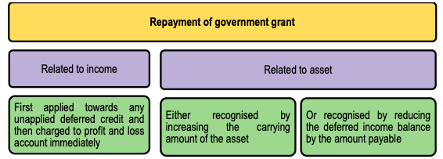

Slide 16
Disclosures
(a) The accounting policy adopted for government grants.
(b) The nature and extent of government grants recognized in the financial statements.
(c) An indication of other forms of government assistance from which the entity has directly benefited. At times, the significance of the benefit of government assistance may be such that disclosure of the nature, extent and duration of the assistance is necessary in order that the financial statements may not be misleading.

Slide 17
Disclosures
(d) The nature and extent of government grants recognised in the financial statements;
(e) Unfulfilled conditions and other contingencies attaching to government assistance that has been recognised.

Slide 18
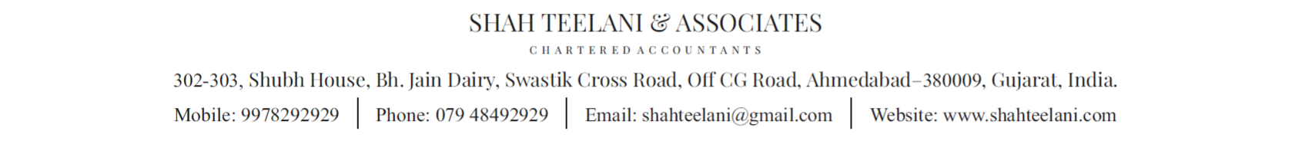
THANK YOU

