Slide 1



BENAMI PROPERTY
TRANSACTIONS
- By Hussain Vaghela

Slide 2
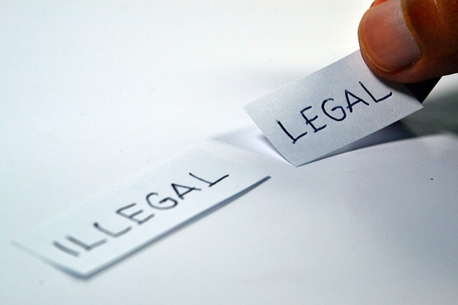
Introduction
Benami is a South Asian word that means “Without name” or “no name”.
Benami Transaction : Is a transaction where a person buys a property in the name of another person or gratuitously transfers property in the name of other person without an intention to benefit that other person.

Slide 3

Why ???
Some people had superstitious belief that certain names were lucky.
Provides an opportunity for putting black money into the market.
To avoid certain political and social risks.
The desire to evade tax thereby committing fraud.

Slide 4
Benami Transactions(Prohibition) Act, 1988
Enacted on September 5,1988
Purpose :
To prohibit benami transactions and to prohibit the right to recover property held benami.
The Benami Transactions (Prohibition) Act, 1988 (‘1988 Act’) was less an Act and more a two-page Statement of Intent. It was shorn of details and the Government had made a promise to flesh out, in the future sometime, the skeletal structure with procedures to be prescribed and rules to be notified in the Official Gazette.
In short, this act never came into force as rules were not framed.

Slide 5
Benami Transactions (Prohibition) Amendment Act, 2016 ("Amendment Act")
Came into force on November 01,2016
The Amendment Act:
has renamed the Principal Act as Prohibition of Benami Property Transactions Act, 1988 ("New Act");
has tried to give a comprehensive definition of benami transactions clearly setting out the transactions to be excluded from the definition;
provides for attachment, adjudication, confiscation and vesting of benami property and has prescribed penalties and punishments in respect of the offences punishable under the New Act.

Slide 6
Benami vis-à-vis Demonetisation
Such an arrangement where a person deposits old currency in the bank account of another person with an understanding that the account holder shall return his money in new currency, the transaction shall be regarded as Benami Transaction under the said Act.
The person who deposits old currency in the bank accounts shall be treated as beneficial owner and the person in whose bank account the old currency has been deposited shall be categorized under this law as Benamidar.
According to the Benami Act, the ‘Benamidar’, the Beneficial Owner and any other person who abets or induces a Benami Transactions, shall be punishable with Rigorous Imprisonment for a period from 1 to 7 years.
The Benami amount in the bank account deposited post Demonetisation will be seized and confiscated and the accused will also liable to fine which may extend up to 25 per cent of the fair market value of the benami property.

Slide 7

Instances
Mr. X acquires the house property in his own name out of black money.
A property gets registered in the name of Mr. Piyush but the person who has paid the full amount of the property is untraceable. This property is known as Benami property and Mr. Piyush is called as benamidar.
Mr. P acquired the house property in the name of his brother.
Mr. X, the trustee of ABC Charitable Trust holds property in his own name out of unknown source of the trust.

Slide 8

Execptions
The karta / members of HUF for the benefit of members.
The person standing in ‘ fiduciary capacity ’ for the benefit of those for whom he stands in his capacity which includes a
Trustee,
Executor,
Partner,
Director, etc.
Spouse or child and consideration paid by known sources of an individual.
Any property held in ‘ Joint Ownership ’ with Brother, Sister, Lineal Ascendant or Lineal Descendant.

Slide 9
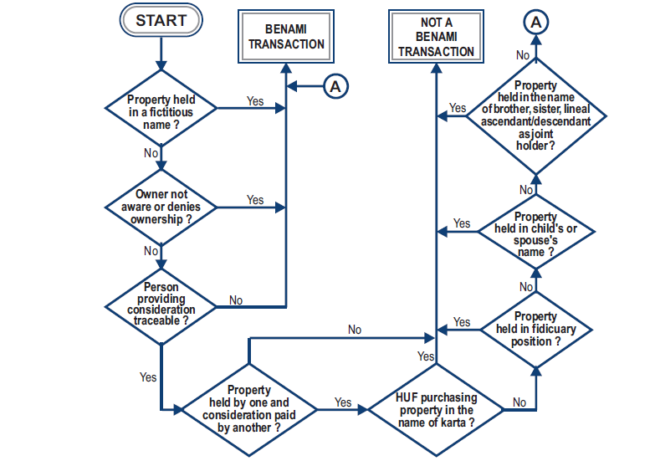
Summary

Slide 10

