Slide 1

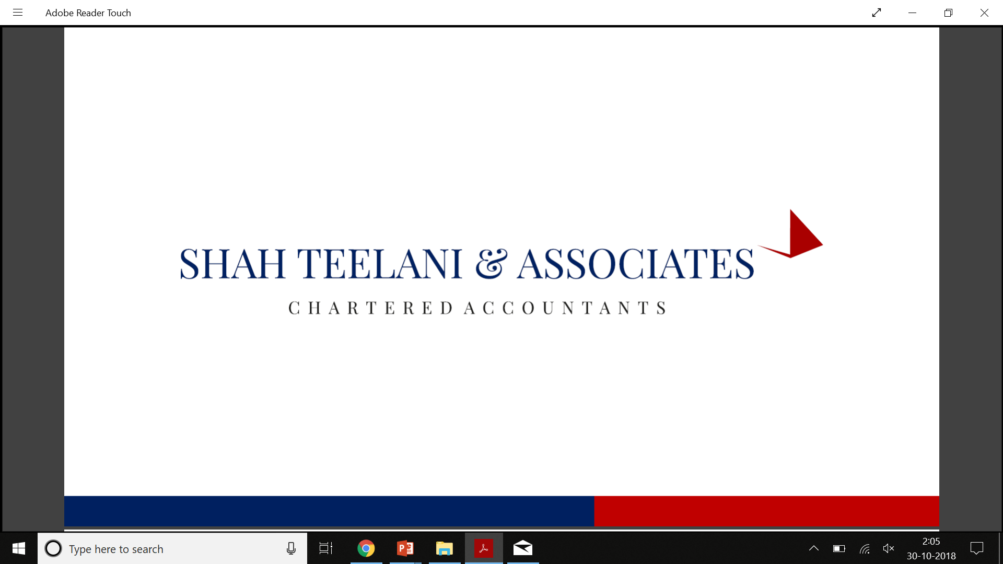

Capital Gain On Share Transaction
By: Nisha Varma

Slide 2
We all know that Income from salary, rental income and business income is taxable. But what about income from sale or purchase of shares?
Many homemakers, retired people, spend their time gainfully buying and selling shares but are unsure of how this income is taxed. Income/Loss from sale of equity shares is covered under the head ‘Capital Gains’.

Slide 3

1. What is a Capital Gain?
Definition: According to section 2(14), a capital asset means –
property of any kind held by an assessee, whether or not connected with his business or profession;
any securities held by a Foreign Institutional Investor which has invested in such securities in accordance with the SEBI regulations.
Simply put, any profit or gain that arises from the sale of a ‘capital asset’ is a capital gain. This gain or profit is comes under the category ‘income’, and hence you will need to pay tax for that amount in the year in which the transfer of the capital asset takes place. This is called capital gains tax, which can be short-term or long-term.
Capital gains are not applicable to an inherited property as there is no sale, only a transfer of ownership. The Income Tax Act has specifically exempted assets received as gifts by way of an inheritance or will. However, if the person who inherited the asset decides to sell it, capital gains tax will be applicable.

Slide 4
SHORT TERM AND LONG TERM CAPITAL ASSETS
Definition – As per section 2(42A), short-term capital asset means a capital asset held by
an assessee for not more than 36 months immediately preceding the date of its transfer.
As per section 2(29A), long-term capital asset means a capital asset which is not a short- term capital asset.
Thus, a capital asset held by an assessee for more than 36 months immediately preceding
the date of its transfer is a long-term capital asset.
Exception - A security (other than a unit) listed in a recognized stock exchange, or a unit of an equity oriented fund or a unit of the Unit Trust of India or a Zero Coupon Bond will, however, be considered as a long-term capital asset if the same is held for more than 12 months immediately preceding the date of its transfer.

Slide 5
Further, a share of a company (not being a share listed in a recognized stock exchange in India) or an immovable property, being land or building or both would be treated as a short- term capital asset if it was held by an assessee for not more than 24 months immediately preceding the date of its transfer.
Before the introduction of budget 2018, long-term capital gain made on sale of equity shares or equity-oriented units of mutual fund was exempt from tax under Section 10(38)
As per the provisions of the Financial Budget of 2018, if a seller makes long term capital gain of more than Rs. 1 lakh on sale of equity shares or equity-oriented units of mutual fund, the gain made will attract a capital gains tax of 10% long-term capital gains tax. Also, the benefit of indexation will not be available to the seller. These provisions apply to transfers made on or after 1 April 2018.

Slide 6
Tax on Short-Term and Long-Term Capital Gains
Tax Type | Condition | Tax applicable
Long-term capital gains tax | Except on sale of equity shares/ units of equity oriented fund | 20%
Long-term capital gains tax | On sale of Equity shares/ units of equity oriented fund | 10% over and above Rs 1 lakh
Short-term capital gains tax | When securities transaction tax is not applicable | The short-term capital gain is added to your income tax return and the taxpayer is taxed according to his income tax slab.
Short-term capital gains tax | When securities transaction tax is applicable | 15%.

Slide 7
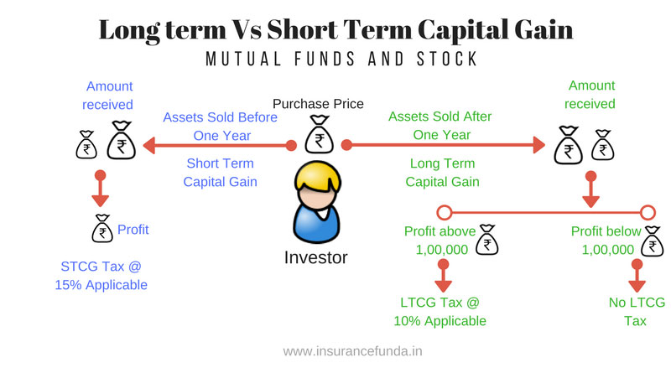

Slide 8
Short-term capital loss
Any short term capital loss from sale of equity shares can be set off against short term or long term capital gain from any capital asset. If the loss is not set off entirely, it can be carried forward for a period of 8 years and adjusted against any short term or long term capital gains made during these 8 years.
It is worthy to note that a taxpayer will only be allowed to carry forward losses if he has filed his income tax return within the due date. Therefore, even if the total income earned in a year is less than the minimum taxable income, filing an Income Tax Return is a must for carrying forward these losses.

Slide 9
Long-term capital loss
Long term capital loss from equity shares until Budget 2018 was considered to be a dead loss – It can neither be adjusted nor carried forward. This is because Long Term Capital gains from listed equity shares were exempt. Similarly, losses from them were neither allowed to be set off nor carried forward.
After the Budget 2018 has amended the law to tax such gains made in excess of Rs 1 lakh @ 10%, the government has also notified that any losses arising from such listed equity shares, mutual funds etc would be allowed to be carried forward. The income tax department has vide its FAQs issued dated 4 February 2018, inter alia clarified that long term capital loss from a transfer made on or after 1 April 2018 will be allowed to be set-off and carried forward in accordance with existing provisions of the Act. Therefore, the long term capital loss can be set-off against any other long term capital gain and unabsorbed long term capital loss can be carried forward to subsequent eight years for set-off against long term gains.

Slide 10
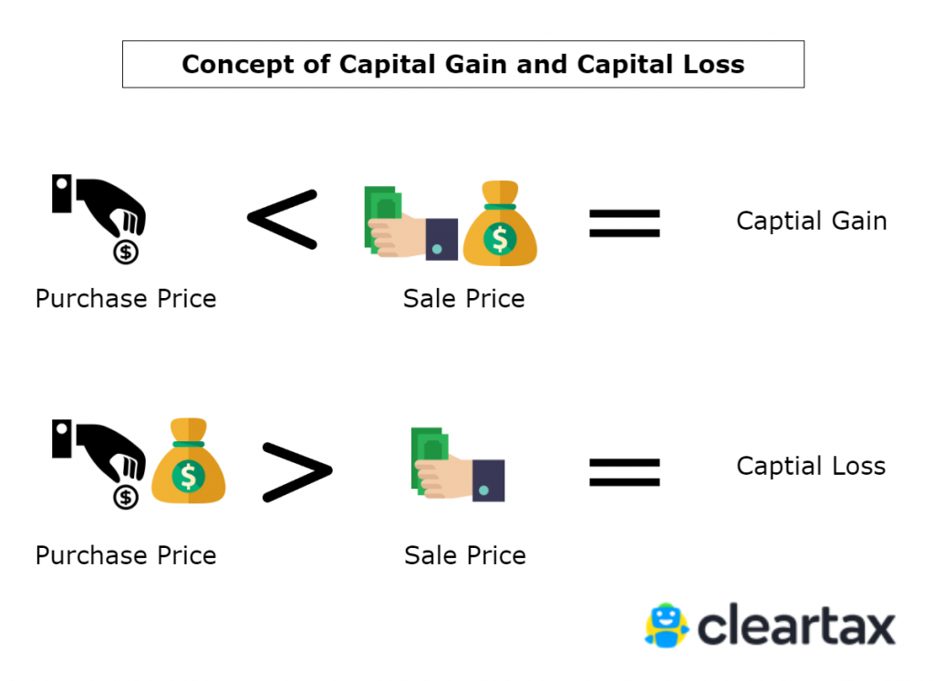

Slide 11
Securities Transaction Tax (STT)
STT is applicable on all equity shares which are sold or bought on a stock exchange. The above tax implications are only applicable for shares which are listed on a stock exchange. Any sale/purchase which happens on a stock exchange is subject to STT. Therefore, these tax implications discussed above are only for shares on which STT is paid.

Slide 12
CAPITAL GAINS ON BUYBACK OF SHARES OR OTHER SECURITIES [SECTION 46A]
In case of specified securities other than shares: Any consideration received by a holder of specified securities (other than shares) from any company on purchase of its specified securities is chargeable to tax in the hands of the holder of specified securities. The difference between the cost of acquisition and the value of consideration received by the holder of securities is chargeable to tax as capital gains in his hands.
In case of shares (whether listed or unlisted): With effect from 5.7.2019, in case of buyback of shares (whether listed or unlisted) by domestic companies, additional income- tax @20% (plus surcharge@12% and cess@4%) is leviable in the hands of the company under section 115QA.

Slide 13
Consequently, the income arising to the shareholders in respect of such buyback of shares by the domestic company would be exempt under section 10(34A), since the domestic company is liable to pay additional income-tax on the buyback of shares.
Note: Prior to 5.7.2019, additional income-tax was attracted only in case of buy back of unlisted shares by domestic companies. Consequently, only holders of unlisted shares were entitled to exemption under section 10(34A).

Slide 14
(1) | (2) | (3) | (4)
Taxability in the hands of | Buyback of shares by domestic companies | Buyback of shares by a company, other than a domestic company | Buyback of specified securities by any company
Company | Subject to additional income-tax@23.296%. | Not subject to tax in the hands of the company. | Not subject to tax in the hands of the company.
Shareholder/ holder of specified securities | Income arising to shareholders exempt under section 10(34A) | Income arising to shareholder taxable as capital gains u/s 46A. | Income arising to holder of specified securities taxable as capital gains u/s 46A.

Slide 15

How to Calculate Short-Term Capital Gains?
Step 1: Start with the full value of consideration
Step 2: Deduct the following:
  Expenditure incurred wholly and exclusively in connection with such transfer
  Cost of acquisition
  Cost of improvement
Step 3: This amount is a short-term capital gain
Short term capital gain = Full value consideration Less expenses incurred exclusively for such transfer Less cost of acquisition Less cost of improvement.

Slide 16
How to Calculate Long-Term Capital Gains?
Long-term capital gain= Full value consideration
Less : Expenses incurred exclusively for such transfer
Less: Indexed cost of acquisition
Less: Indexed cost of improvement
Less:expenses that can be deducted from full value for consideration*
(*Expenses from sale proceeds from a capital asset, that wholly and directly relate to the sale or transfer of the capital asset are allowed to be deducted. These are the expenses which are necessary for the transfer to take place.)

Slide 17
Sale value: It is the value received or receivable on the capital asset sale.
In the case of equity shares or mutual fund (MF) units, the gross selling price (excluding the brokerage charges and securities transaction tax or STT is considered as the sale value.
Cost of acquisition: It is the purchase price of the asset which has been sold. The brokerage charges paid to buy the asset have to be included in the purchase price.
In case of any equity shares or units of equity-oriented mutual funds purchased before February 1, 2018, the COA would be computed in the following manner:
Step 1: Compute the fair market value of your investment. To compute this value multiply your number of shares or MF units with their respective highest prices as on January 31, 2018.
Step 2: Take the actual sale value of your investment.
Step 3: Choose the lower value out of the above two.
Step 4: Compare the value arrived at step 3 with the actual purchase value of the investment and choose the higher value. This will be your cost of acquisition.

Slide 18
Cost of improvement: It is the money spent on major repairs or modifications of the asset. A whitewash, however, will not be counted as a cost of improvement, whereas money spent on major modifications, like constructing a floor or an additional room, will qualify as cost of improvement.

Slide 19
Guidance for treating share sale as business income
Certain taxpayers treat gains or losses from the sale of shares as ‘income from business’, while certain others treat it as ‘Capital gains’. Whether your gains/losses from sale of shares should be treated as business income or be taxed under capital gains, has been a matter of much debate. In case of significant share trading activity (e.g. if you are a day trader with lots of activity or if you trade regularly in Futures and Options), usually your income is classified as income from business. In such a case you are required to file an ITR-3 and your income from share trading is shown under ‘income from business & profession’.
When you treat the sale of shares as business income, you are allowed to reduce expenses incurred in earning such business income. In such cases, the profits would be added to your total income for the financial year, and consequently be charged at tax slab rates.
If you treat your income as capital gains, expenses incurred on transfer are deductible. Also, long term gains from equity above Rs 1 lakh annually are taxable, while short term gains are taxed at 15%.

Slide 20
Example
Ms. Usha purchases 1,000 equity shares in X Ltd., an unlisted company, at a cost of ` 30 per share (brokerage 1%) in January 1996. She gets 100 bonus shares in August 2000. She again gets 1,100 bonus shares by virtue of her holding on February 2006. Fair market value of the shares of X Ltd. on April 1, 2001 is ` 80.
On 1st January 2020, she transfers all her shares @ ` 200 per share (brokerage 2%). Compute the capital gains taxable in the hands of Ms. Usha for the A.Y. 2020-21
Cost Inflation Index for F.Y. 2001-02: 100, F.Y.2005-06: 117 & F.Y.2019-20: 289.

Slide 21
Computation of capital gains for the A.Y. 2020-21
Particulars | `
1000 Original shares
Sale proceeds (1000 × ` 200) | 2,00,000
Less : Brokerage paid (2% of ` 2,00,000) | 4,000
Net sale consideration | 1,96,000
Less : Indexed cost of acquisition [` 80 × 1000 × 289/100] | 2,31,200
Long term capital loss (A) | (35,200)
100 Bonus shares
Sale proceeds (100 × ` 200) | 20,000
Less : Brokerage paid (2% of ` 20,000) | 400
Net sale consideration | 19,600
Less : Indexed cost of acquisition [` 80 × 100 ×289/100] [See Note below] | 23,120
Long term capital loss (B) | (3,520)

Slide 22
1100 Bonus shares
Sale proceeds (1100 × ` 200) | 2,20,000
Less: Brokerage paid (2% of `2,20,000) | 4,400
Net sale consideration | 2,15,600
Less: Cost of acquisition | NIL
Long term capital gain (C) | 2,15,600
\ Long term capital gain (A+B+C) | 1,76,880

Slide 23

Thank You
Nisha varma

