Slide 1



GSTR-1 RETURN FILLING
Presentation - By Chavda Amit.

Slide 2
GSTR 1 FILLING ONLINE
Quarterly return for registered dealer with aggregate turnover up to Rs. 1.50 Crores
Ex. GSTR-1(Jan-Mar,)
Due Date will be Apr 30th,
Turnover exceeding Rs. 1.50 Crores the reurn to file monthly.
Ex. GSTR-1 for Feb,
Due Date will be Mar 11th,

Slide 3
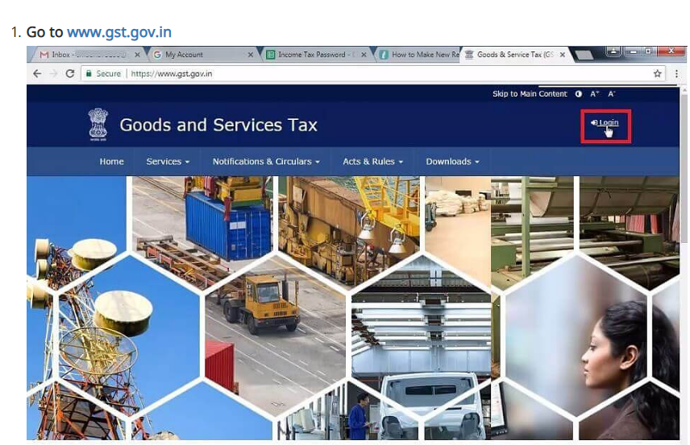
GSTR -1 FILLING

Slide 4
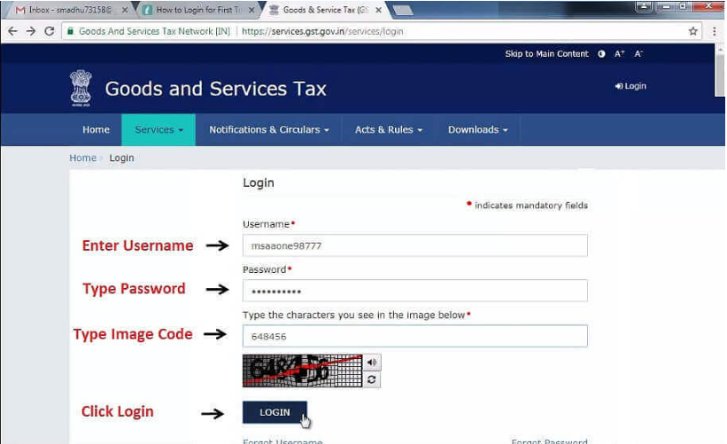

Slide 5
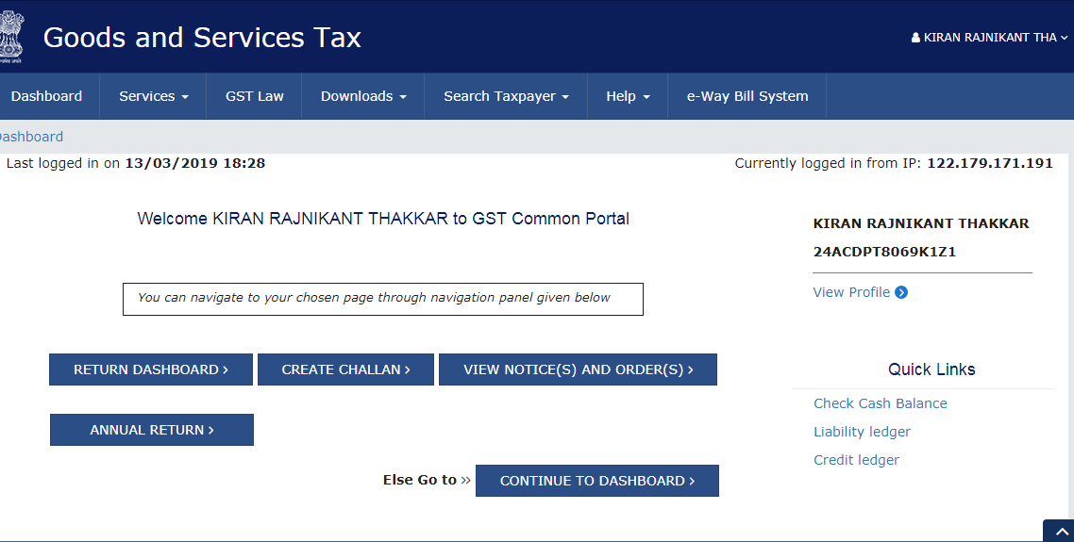

Slide 6
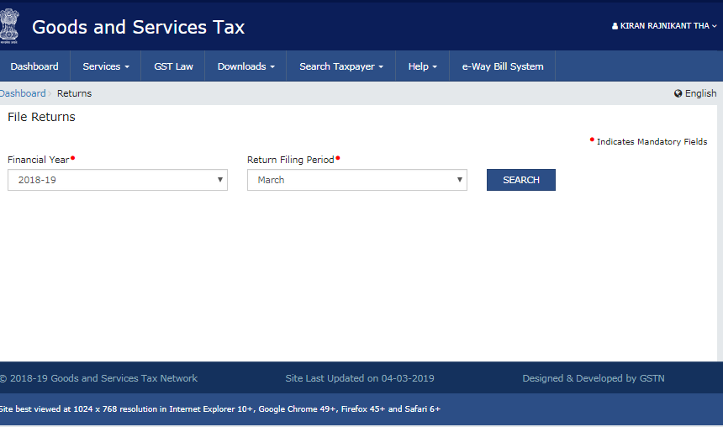
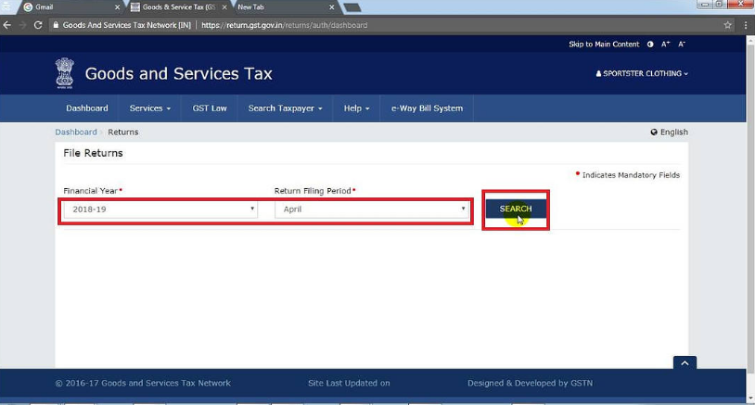

Slide 7
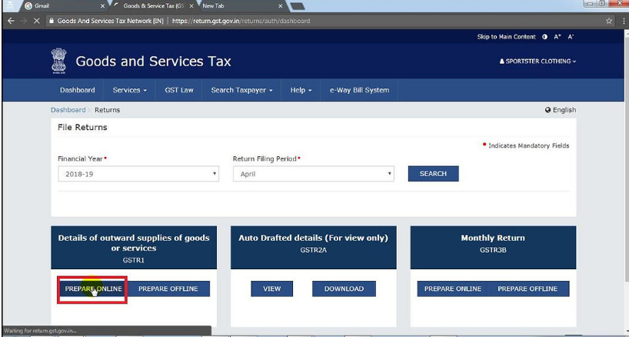

Slide 8
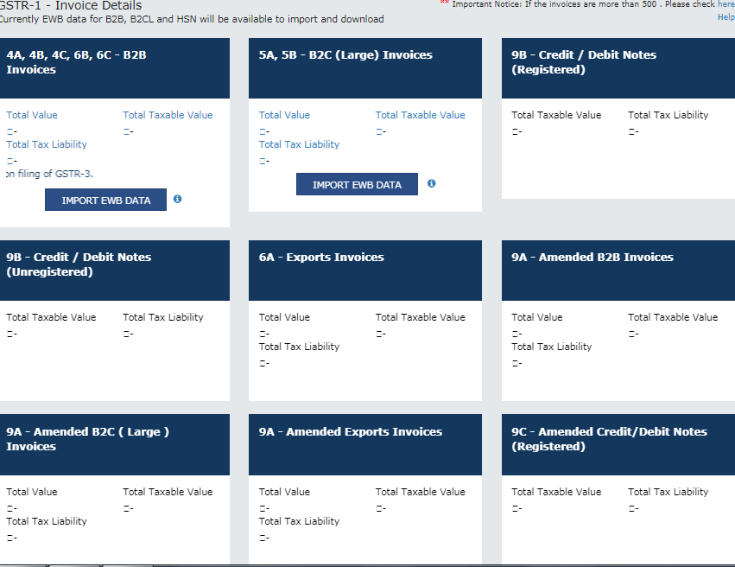

Slide 9
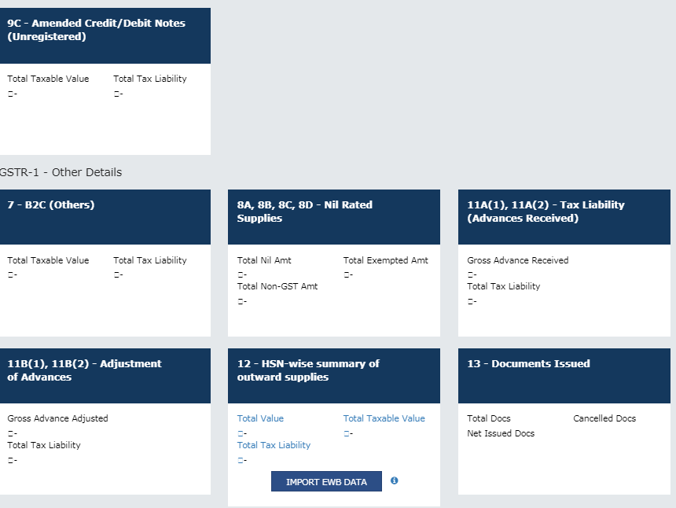

Slide 10
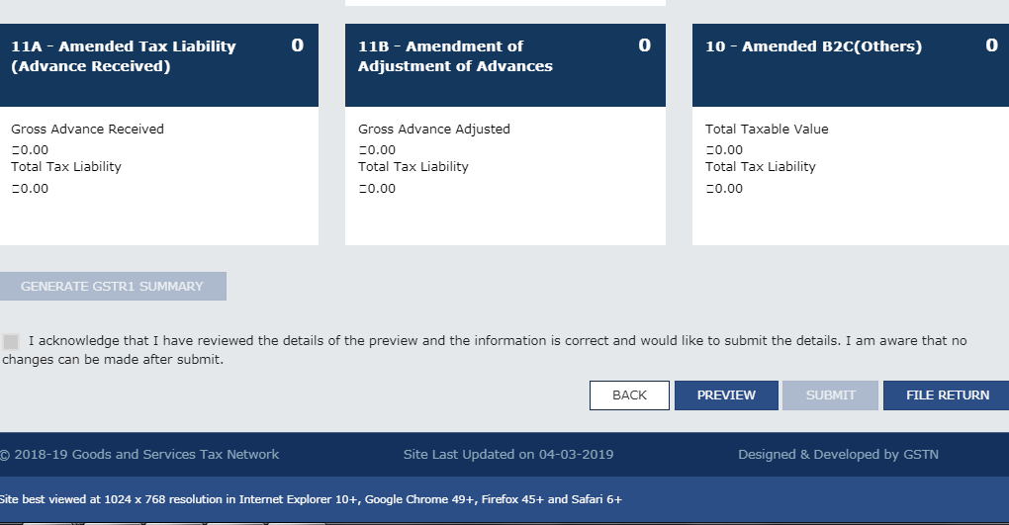

Slide 11
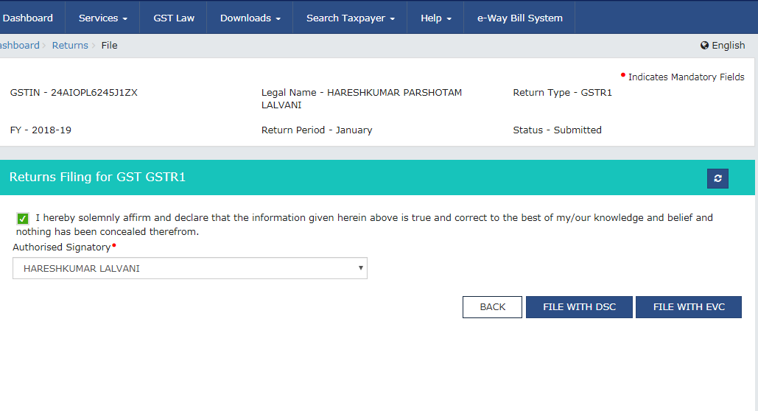

Slide 12
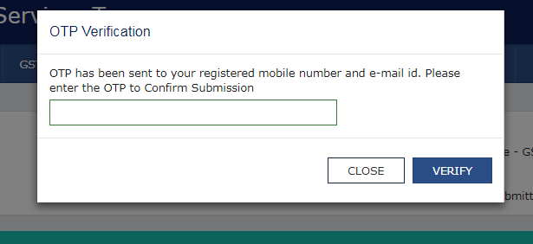

Slide 13
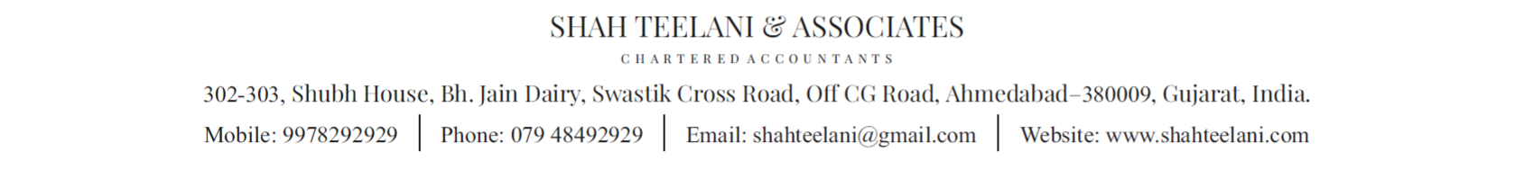
THANKS YOU

