Slide 1
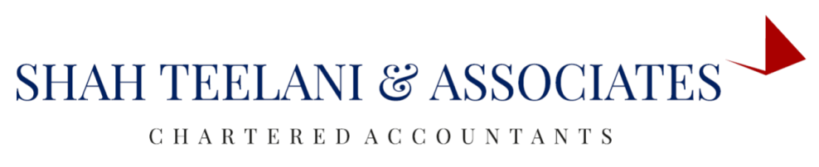

ANNUAL RETURN : GSTR-9A
- BY AMRUTA MAKWANA

Slide 2
Who should file GSTR-9A?
All taxpayers registered under the composition levy scheme under GST should file GSTR-9A.
However, the following persons are not required to file this :
Non-resident taxable persons
Input service distributor
Casual Taxable Person
Persons paying TDS under section 51 of the Act
E-commerce operator paying TCS under section 52 of the Act

Slide 3
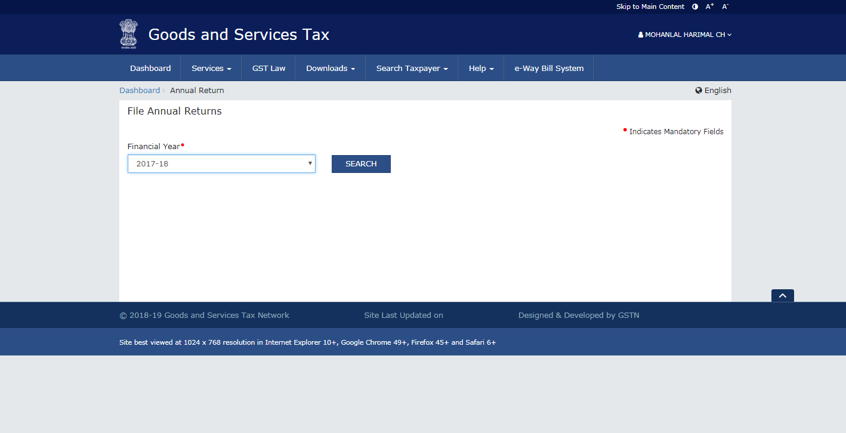

Slide 4
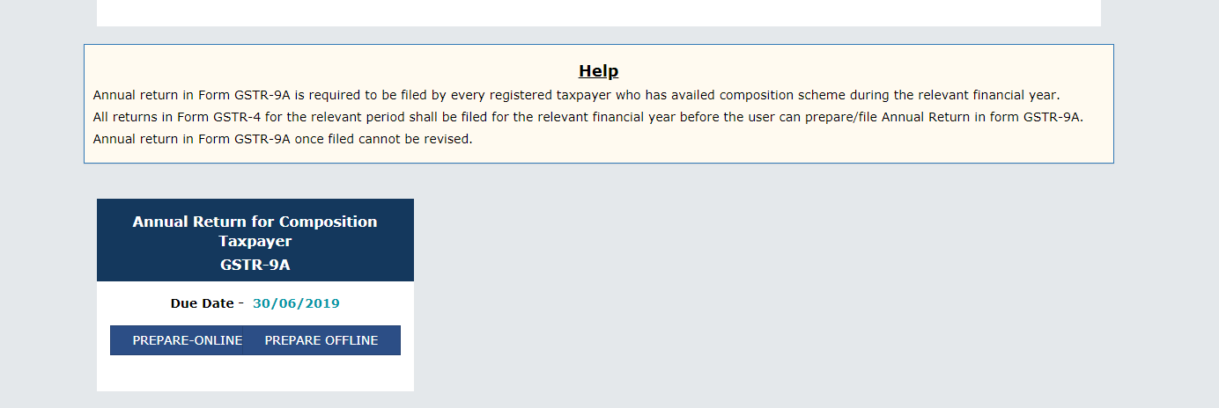

Slide 5
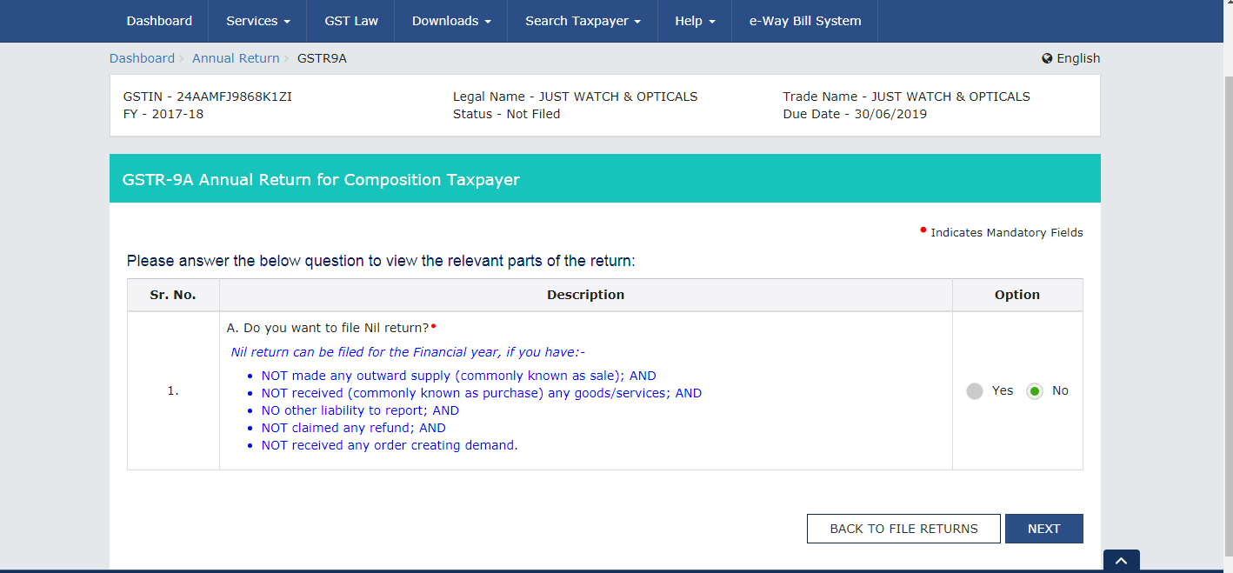

Slide 6
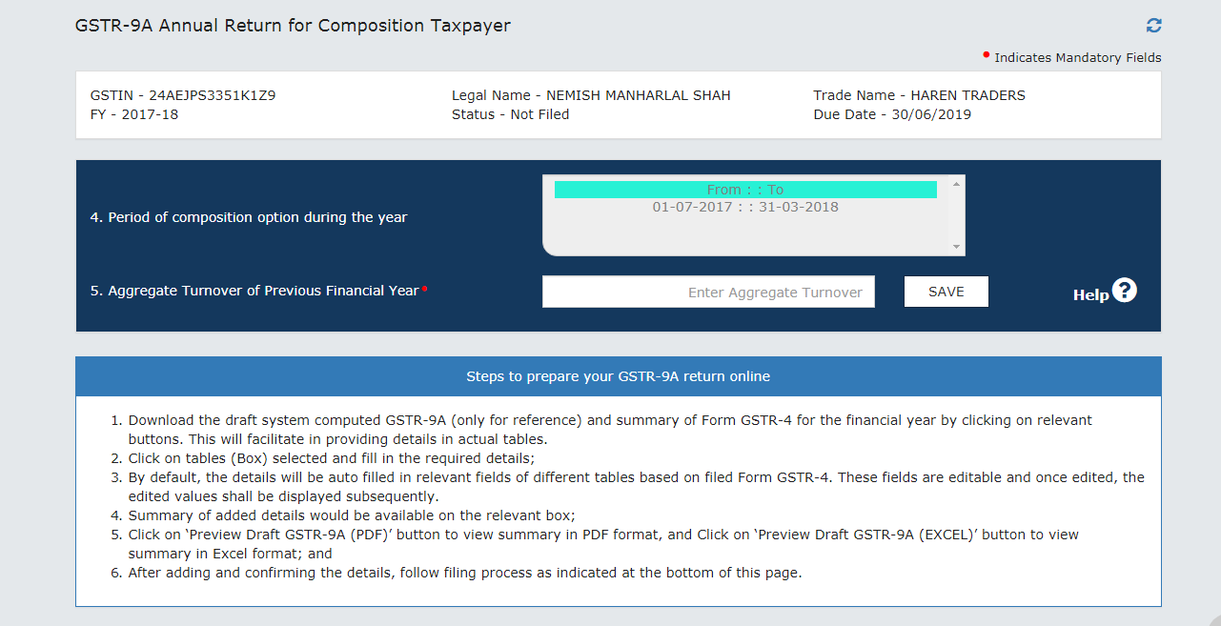

Slide 7
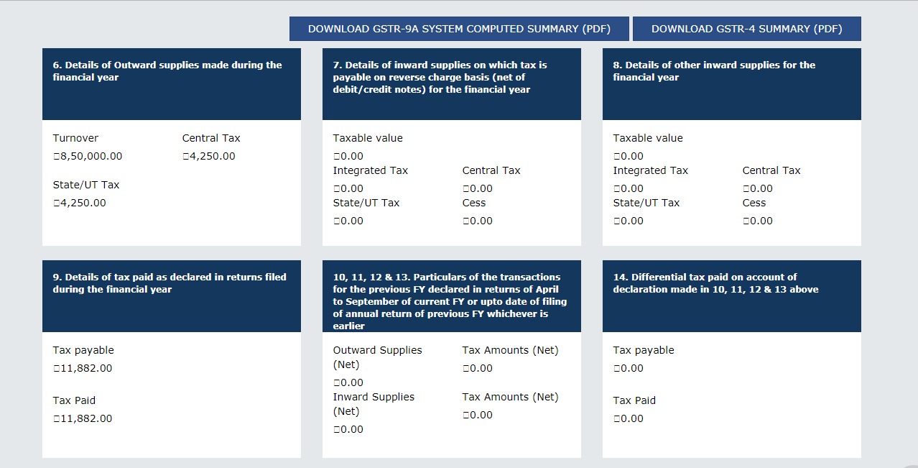

Slide 8
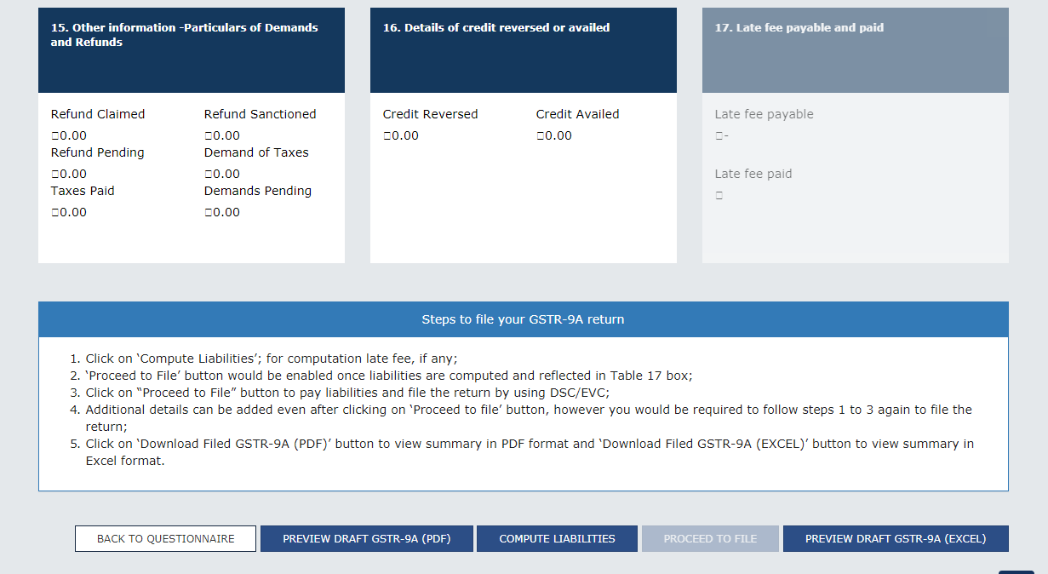

Slide 9
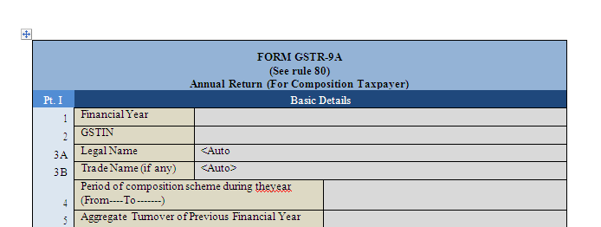

Slide 10
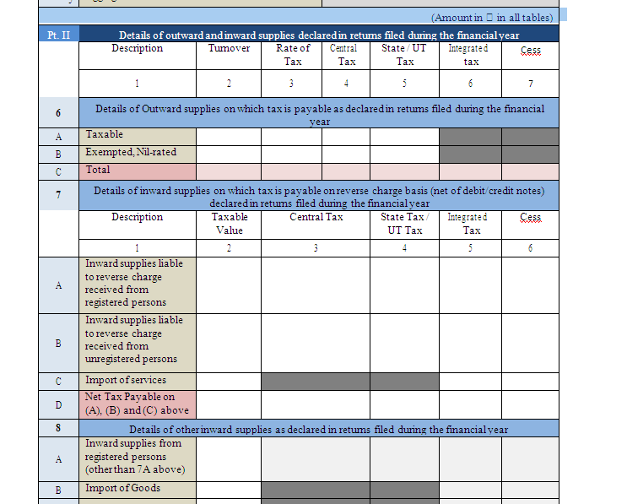

Slide 11
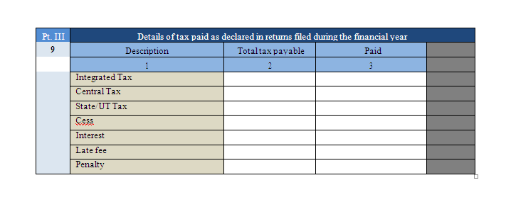

Slide 12
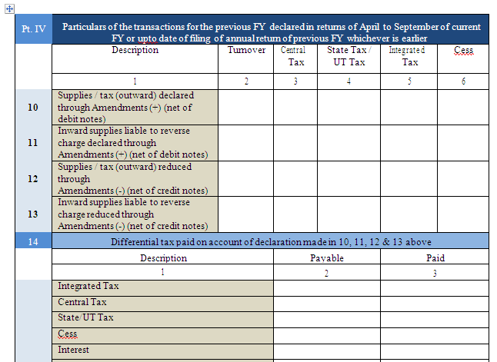

Slide 13
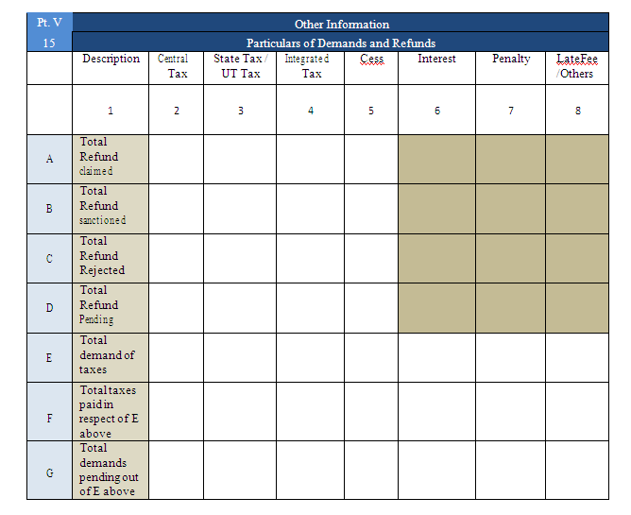

Slide 14
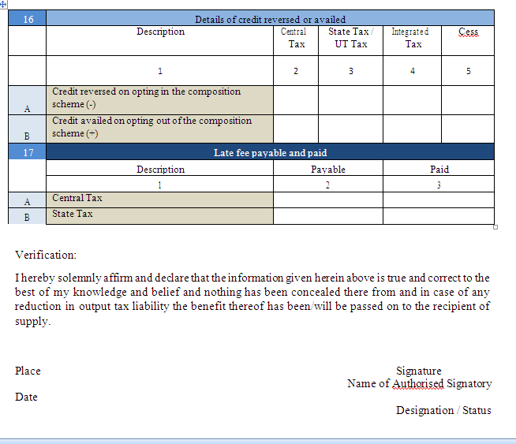

Slide 15
When is GSTR-9A due?
Latest Update as on 22nd December 2018: Due date for filing all annual forms is further extended till 30th June 2019 by CBIC for FY 2017-18
Update as on 8th December 2018: Due date for filing GSTR-9, GSTR-9A and GSTR-9C is extended till 31st March 2019 by CBIC for FY 2017-18

Slide 16
What is the penalty for the late filing of GSTR-9A?
Under CGST | Under SGST/UTGST | TOTAL
Rs.100* per day of default | Rs.100* per day of default | Rs.200 per day of default
*Maximum late fee per day cannot exceed 0.25% of Turnover in the State or Union territory under CGST/SGST/UTGST.

Slide 17
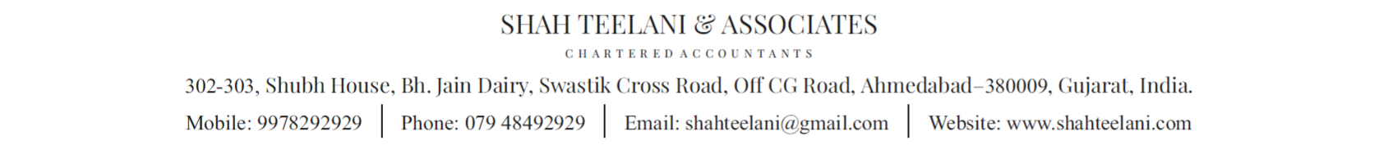
THANK YOU

