Slide 1


IBC
INSOLVENCY & BANKRUPTCY CODE,2016
BY
PURVA CHUDASAMA

Slide 2
WHY CODE AND NOT AN ACT ?
MEANING
COVERAGE
EXISTING & NEWLY CREATED
COMPLETE STATEMENT

Slide 3

MEANING OF INSOLVENT & BANKRUPTCY
LIABILITIES ARE MORE THAN ASSETS
YOU ARE UNABLE TO PAY THE AMOUNT
INSOLVENCY
LIABILITIES
ASSETS

Slide 4


MEANING OF INSOLVENCY & BANKRUPTCY
DECLARES
TO A NON –CORPORATE
INSOLVENT
court
BANKRUPTCY

Slide 5

MEANING OF INSOLVENCY & BANKRUPTCY
INSOLVENCY
BANKRUPTCY

Slide 6



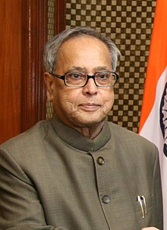
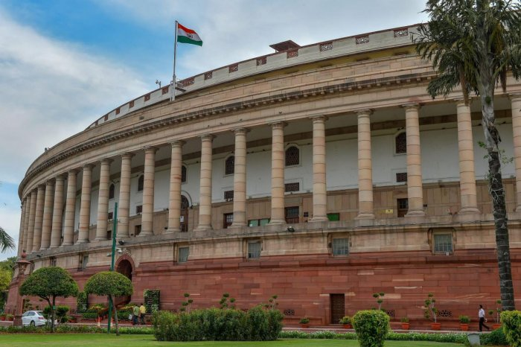
HOW IBC CAME INTO EFFECT IN INDIA ?
23 DEC 2015
Joint committee of parliament

Slide 7
PRESIDENCY TOWNS INSOLVENCY ACT , 1909
PROVINCIAL INSOLVENCY ACT ,1920
INDIAN PARTNERHIP ACT, 1932
NEED OF IBC
COMPANIES ACT , 1956
SICK INDUSTRIES COMPANIES ACT , 1985
RECOVERY OF DEBTS DUE TO BANKS & FINANCIAL INSTITUTIONS ACT, 1993
SALES ACT, 2002
COMPANIES ACT ,2013
INSOLVENCY & BANKRUPTCY CODE , 2016

Slide 8
NEED
INFORMATI-ON UTILITIES
PROTECTING INTEREST OF CREDITORS , EMPLOYEES AND WORKMEN
AUTHORIZE STRUCTURE
TIMELY RESOLUTION
SINGLE LAW

Slide 9
FRAMEWORK OF IBC
REGULATORS
ADJUDICATORS
IBBI
NCLT
DRT
IRP
IP
IU

Slide 10
COMPOSITION OF IBC
CORPORATE INSOLVENCY RESOLUTION PROCESS (CIRP)
FAST TRACK CORPORATE INSOOLVENCY RESOLUTION PROCESS
LIQUIDATION PROCESS
VOLUNTARY LIQUIDATION PROCESS

Slide 11
TIME LIMIT
PROCESS | TIME LIMIT | EXTENSION
CIRP | 180 DAYS | 90 DAYA
FAST TRACK CIRP | 90 DAYS | 45 DAYS
LIQUIDATION | 1 YEAR | NOTHING PRESCRIBED AS SUCH IN LAW
VOLUNTARY LIQUIDATION | NO TIME LIMIT IS PRESCRIBED IN LAW

Slide 12
1
2
COC
3
180+90 DAYS
4
FINAL RESOLUTION
NCLT/DRT
14 DAYS
IP
DEBT RECAST PLAN
RESOLUTION PROCESS

Slide 13
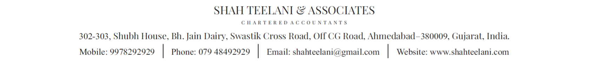
THANK YOU

