Slide 1
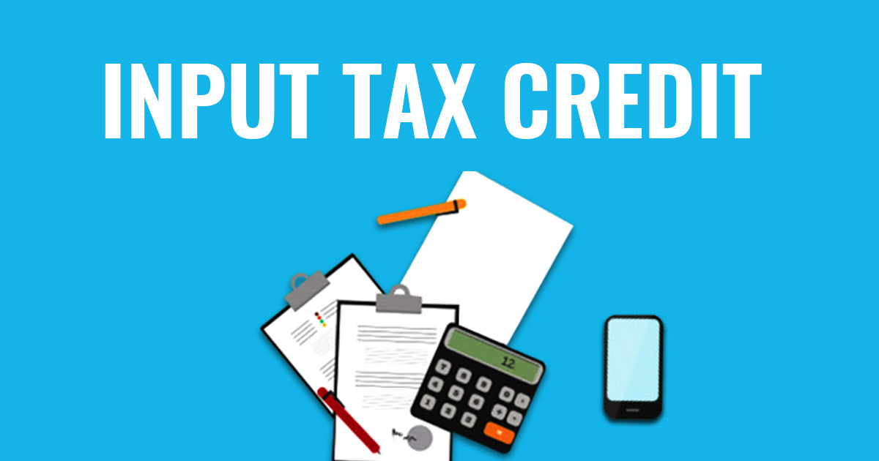


ENTER SUB TITLE HERE

Slide 2
Overview
Input Tax Credit or ITC is the tax that a business pays on a purchase and that it can use to reduce its tax liability when it makes a sale. In other words, businesses can reduce their tax liability by claiming credit to the extent of GST paid on purchases.

Slide 3
Input tax credit-major principles
Allow credit on taxes paid on all purchases intended for further sale.
Allow credit of taxes paid on all other business expenses.
Personal expenses are not creditable.
It should be used or intended to be used in the course or furtherance of business.

Slide 4
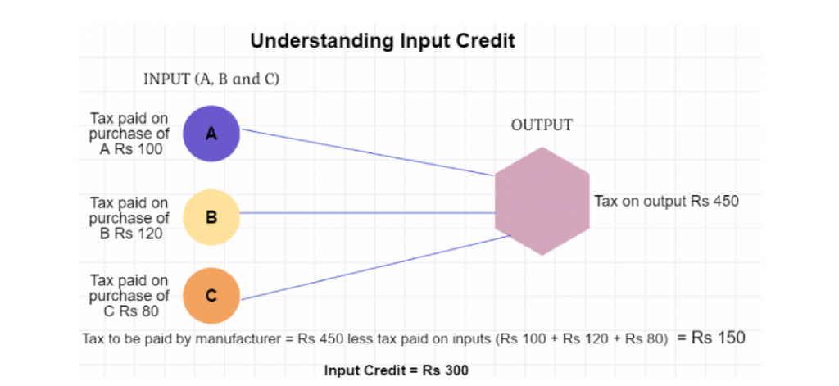
Understanding input credit

Slide 5
Conditions for availing of ITC
Failure to the supplier towards supply of goods and/or services within 180 days from the date of invoice, ITC already claimed will be added to output tax liability and interest to paid on such tax involved.
You must have a tax invoice(of purchase) or debit note issued by registered dealer
No ITC will be allowed if depreciation have been claimed on tax component of a capital good
Goods / service should have been received/deemed to be received by the taxable person
The timelines for entitlement of credit against a particular invoice shall lapse on the expiry of one year from date of issue of invoice.
The tax charged on your purchases has been deposited/paid to the government by the supplier in cash or via claiming input credit
Supplier has filed GST returns

Slide 6
Apportionment of input tax credit
If goods or services or both are used by registered person partly for business and partly for other purposes then credit is restricted to input tax attributable to business purposes.
If partly for taxable supply and partly for exempted supply then credit is restricted to attributable to taxable supply.

Slide 7
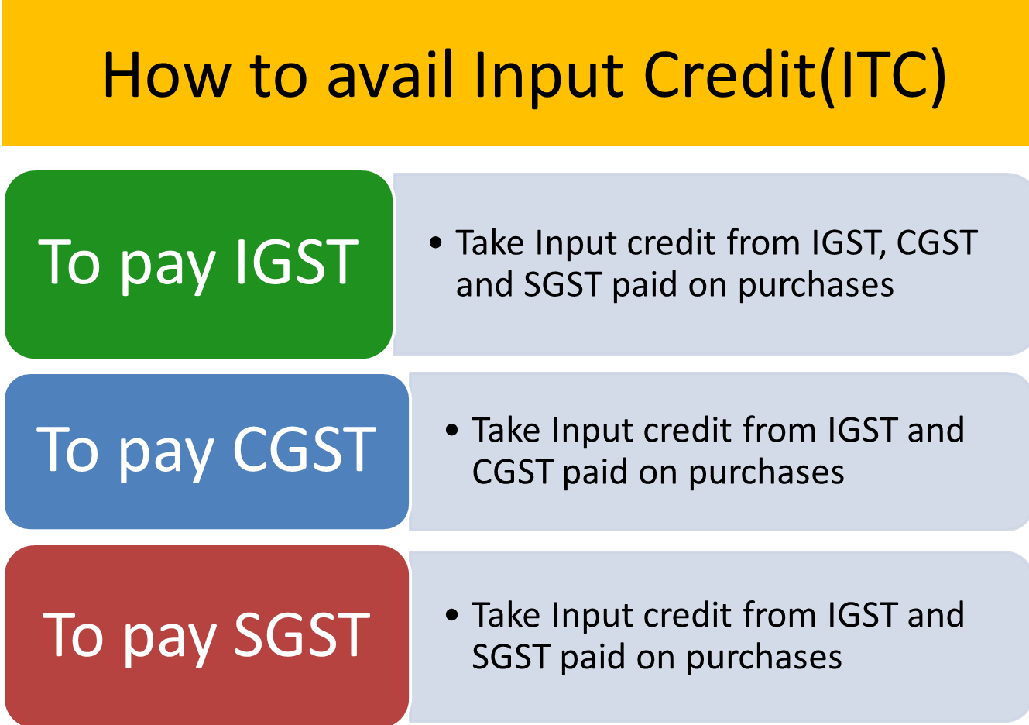
How to avail Input Credit(ITC)

Slide 8
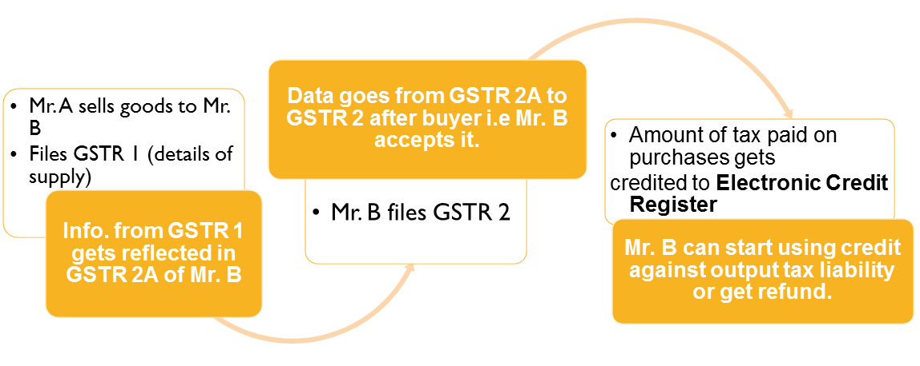
Procedure to availing ITC
Mr. A sells goods to Mr B
Files GSTR I (details of supply)
Data goes from GSTR 2A to GSTR2 after buyer i.e. Mr. B accepts it.
Amount of tax paid on purchase gets credited to Electronic Credit Register
Info. from GSTR 1 gets reflected in GSTR2A of Mr.B
Info. from GSTR 1 gets reflected in GSTR2A of Mr. B
Mr. B can start using credit against output tax liability or get refund.

Slide 9
Allowance/Disallowance of input tax credit
Under the GST regime, ITC can be claimed by every registered taxable person on all inputs used or intended to be used (weather goods or services) in the course of or for the furtherance of business.
(except in certain specified cases)

Slide 10
Ineligible credit:
Motor vehicles used except when supplied in the usual course of business or for providing taxable service of transportation of passengers, goods and training/driving skills.
Goods or services used mainly for the purpose of personal use or consumption of employees.
Goods or services on which composition tax has been paid.
Goods or services used for private or personal consumption.

Slide 11
Ineligible credit:
Works contract services for construction of immovable property other than plant and machinery.
Goods lost/stolen/destroyed/written off or disposed off by way of gift/free samples.
Membership of club/health and fitness centre.
Travel benefits to employees.
ITC is not eligible on invoice after filing of return for the month of September or filing of annual return for the said year whichever is earlier.

Slide 12
Reversal of input tax credit
Non-payment of invoices in 180 days
Inputs partly for business purpose and partly for exempted supplies or for personal use
Credit note issued to ISD by seller
Capital goods partly for business and partly for exempted supplies or for personal use
ITC reversed is less than required

Slide 13
Payment of tax
Electronic cash ledger
Amount deposited in cash credited here
Electronic credit ledger
Input tax credit shall be credited here
May be used for making payment towards tax,interest,penalty,fees or any other amount
May be used for making payment towards tax payable

Slide 14
Time period to avail ITC
1 YEAR FROM THE DATE OF INVOICE
SEPTEMBER FOLLOWING THE END OF FINANCIAL YEAR
DATE OF FILING OF RETURN
WHICHEVER IS EARLIER

Slide 15
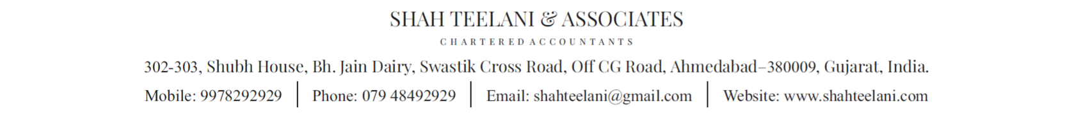
THANK YOU
A presentation by-
Aditya chandnani

