Slide 1
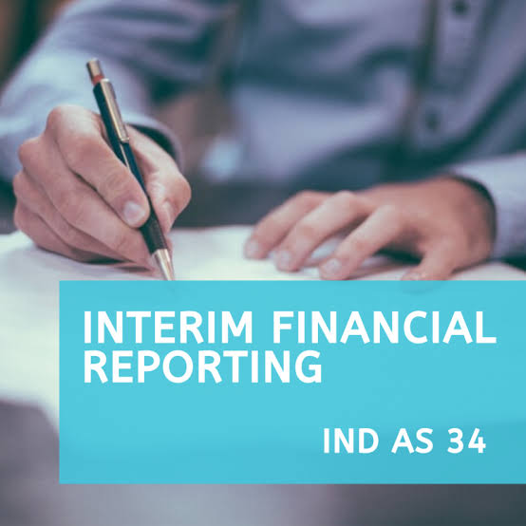


By Kavi Nandaniya

Slide 2
What is interim period?
Interim period is a financial Reporting period should be shorter than a full financial year.
What is interim financial reporting?
Interim financial reporting is a financial Reporting containing
1.A complete set of a financial statement
Or
2.A condensed set of financial statement
(summary based financial statement)

Slide 3
Exception:
1.Incorporation :
Ex. Date of incorporation is 01/10/2019 to 31/03/2020 for that period First fs of the entity is Prepared.
2.liquidation:
Ex.01/04/2019 to 31/12/2019 i.e.Date of liquidation
In above both case financial statement are prepared for shorter than a full financial year then also is not considered as a interim financial statement.

Slide 4

Objective of ind as 34: ind as 34 is to be prescribe The minimum content Of an interim financial report And to prescribe the principal for recognition and measurement In complete and condensed financial statement.

Slide 5
Presentation and Disclosure
Complete:
  Detailed statement similar to annual report.
  (As per ind as 1)
Condensed:
Financial statement include
Condensed balance sheet
Condensed statement of profit or loss
Condensed cash flow statement
Selected explanatory notes
Condensed statement of change in equity
Ind as 34 is encouraged condensed Set of financial statement

Slide 6
If company follow condensed set of fs then following disclosure should be required
Same heading and sub-heading
Season of The business
Same accounting policies followed,if change than disclose
Basic and diluted EPS
Segment report for interim period
Change in accounting estimate
Contingency
Special transaction
Dividend

Slide 7
Recognition and measurement
Discretionary view:
interim period is considered as a independent periods.
All items accounted as per discretionary view (as per accrual concept)
Integral view:
here interim period is considered as a integral part of annual period.
Only income tax accounted as per this view.

Slide 8
EXAMPLE:
XYZ Ltd.is prepare interim financial report for Quarter 1
Qtr. income result Step 1 : Annual income=400
100 Actual Step 2: Annual Tax=(400-100)×30%=90
100 Estimated Step 3: WATR=Annual Tax÷Annual income×100
100 Estimated 90÷400×100=22.5%
100 Estimated Step 4:Tax Expenses
Q1=100×22.5%=22.5
Carry forward losses =100
Tax rate =30%

Slide 9


For any corporate solution please contact team SHAH TEELANI AND ASSOCIATES, AHMEDABAD

