Slide 1


INTERNAL AUDIT
FROM
GAGAN REBARI

Slide 2
OVERVIEW OF INTERNAL AUDIT
INTERNAL AUDIT :
Internal Audit is done to evaluate company’s internal controls, including its corporate governance and accounting processes. To ensure compliance with laws and regulations and it help to maintain accurate and timely financial reporting and data collection. Internal audit also provides management with tools necessary to attain operational efficiency by identifying problems and correcting lapses before they are discovered in external audit.
Internal Audit Process :
Internal auditor generally identify a department, gather an understanding of the current internal control process, conduct fieldwork testing, follow up with department staff about identified issues, prepare an official audit report, review the audit report with management, and follow up with management and the board of directors as needed to ensure recommendations have been implemented.

Slide 3
Why Internal Audit is required
Detection of frauds:
Regular internal audits assess a company’s controls and help uncover evidence of fraud, waste or abuse. The frequency of internal audits will depend on the department or process being examined. For example, in large organisation, daily audits may be required, while for smaller organisation,weekly or monthly review may be sufficient.
Quality control:
Internal auditors play the role of combining assurance and consulting. Assurance informs the management how well systems and processes are designed to keep the company’s goals on track. Consulting advises the management on how to improve those systems and processes if and when necessary.
Confidence to stakeholders & Owner:
The internal auditor reports to executive management that important risks have been evaluated and necessary improvements highlighted. This executive management and boards to demonstrate that they are managing the organisation effectively on behalf of their stakeholders.
Management Advisory :
Internal audit looks into the extent of implementation of management policies, as well as the tone and risk management culture of a company. This aids the management to modify or recourse company action plans.

Slide 4
WORLDCOM CASE
IN 2002 One of the world largest telecommunication company Worldcom filed for bankruptcy after fraud of $3.8 billion was discovered
Had there been strong Internal Control, the collusion carried out by top management and accountants would have been identified earlier.
This fraud was detected by internal auditor of Worldcom named Cynthia cooper
Cooper and her team of auditor worked together and often at night and in secret to investigate and unearth the biggest fraud in US history.
They found that revenue expenditure were capitalised in books and fictitious journal entries were recorded in books resulted in overstatement of profit in books
The impact of the fraud was that US govenment Passed SARBANES AND OXLEY ACT,2002 which mandated companies top management to report on internal control compliance.

Slide 5
Worldcom Internal Control Weakness
Control Environment:
Top management subject to extreme pressures, e.g. unrealistic targets linked to extreme bonus schemes •No whistle-blower function •Management took advantage of employee loyalty, and encouraged them to wrongly record journal entries
Control Activities
Lack of organisational instructions, manuals, policies and procedures •Lack of financial data controls, resulting in hidden collusive fraud •Lack of documentation, especially since entries were sometimes initiated via calls •Management deliberately withheld/ limited access to accounting system info, to conceal fraudulent activities
Monitoring
Internal monitoring process was wrongly organised & didn’t provide management with direction and guidance •IA department was understaffed with only 35 auditors. For a global group, Worldcom should have had at least 100 auditors.

Slide 6
SECTION 138 OF COMPANIES ACT 2013
Internal Audit has been mandated by Section 138 of the Companies Act, 2013 upon the Companies which come under the purview of prescribed thresholds. The said companies have to perform the internal audit checks on a regular basis so as to ensure that they are not deviating from any material compliance instructed by any regulatory or governing body.
Section 138 provides that the Companies are required to appoint a person as an internal auditor who needs to be a professional. The said person can be chartered accountant or a cost accountant, or such other professional as may be decided by the Board. The term professionals is a wider term which facilitates other professionals such as Company Secretaries or Lawyers to be appointed as internal auditors and to ensure timely compliance checks on a company.
The internal auditor may or may not be the employee of the Company;
The term ‘chartered accountant’ shall mean a Chartered Accountant whether engaged in the practice or not.
The Audit Committee of the Company or the Board shall, in connection with the Internal Auditor, formulate the scope, functioning, periodicity and methodology for conducting the internal audit Therefore the Act has given the power to the Board/the Audit committee to define the scope of work of the Internal Auditor. The Act does not prescribe any specific time frame for conducting an internal audit but it is considered a good practice to conduct the Audit on a quarterly basis so that the compliances are monitored properly and there are no frauds or deviations in the Company.

Slide 7
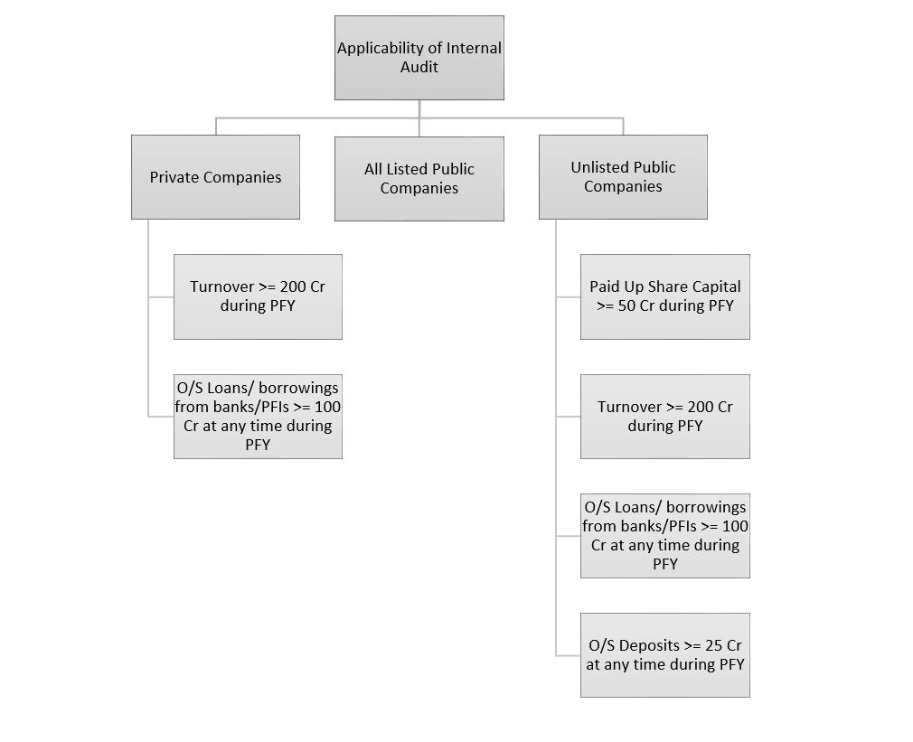

Slide 8
Outsourcing the Internal Audit Function
Organisations may develop an in-house IA function, and can also outsource this function
BENEFITS
1.Specialist knowledge due to the experience obtained from various clients, which increases quality 2.Improves objectivity and independence 3.Provides access to leading-edge tools and methodologies 4.Transfer of knowledge and capabilities to the organisation 5.Greater Authority
DRAWBACKS
1.The use of specialist knowledge may prove to be expensive, which may discourage directors 2.Knowledge of the client needs to be refreshed upon every visit 3.Management may take the impression that responsibility has now been passed to the outsourced provider

Slide 9
STANDARD ON INTERNAL AUDIT
ISSUED BY ICAI
The Standards on Internal Audit (SIAs) establish uniform evaluation criteria, methods, processes and practices. The Standards are pronouncements which form the basis for conducting all internal audit activity. These pronouncements are designed to help the internal auditor to discharge his responsibilities.
The Standards on Internal Audit, as and when issued, will be classified and numbered in a series format, as follows:
(i)100 Series: Standards on Key Concepts
(ii)200 Series: Standards on Internal Audit Management
(iii)300–400 Series: Standards on the Conduct of Audit Assignments
(iv)500 Series: Standards on Specialised Areas
(v)600 Series: Standards on Quality Control
(vi)700 Series: Other/Miscellaneous Matters

Slide 10
INTERNAL AUDITOR RESPONSIBILITY
Identify and assess areas of significant business risk.
Implement best audit and business practices in line with applicable internal audit statements.
Manage resources and audit assignments.
Identify and reduce all business and financial risks through effective implementation and monitoring of controls.
Develop, implement and maintain internal audit policies and procedures in accordance with local and international best practice.
Compile and implement the annual Internal Audit plan.
Conduct ad hoc investigations into identified or reported risks.
Oversee risk-based audits covering operational and financial processes.
Ensure complete, accurate and timely audit information is reported to Management and/or Risk Committees.

Slide 11
DIFEERENCE BETWEEN INTERNAL AUDIT & EXTERNAL AUDIT
Basis for Comparison | Internal Audit | External Audit
Meaning | Internal Audit refers to an ongoing audit function performed within an organization by a separate internal auditing department. | External Audit is an audit function performed by the independent body which is not a part of the organization.
Objective | To review the routine activities and provide suggestion for the improvement. | To analyze and verify the financial statement of the company.
Conducted by | Employees | Third Party
Auditor is appointed by | Management | Members
Users of Report | Management | Stakeholders
Opinion | Opinion is provided on the effectiveness of the operational activities of the organization. | Opinion is provided on the truthfulness and fairness of the financial statement of the company.
Scope | Decided by the management of the entity. | Decided by the statute.
Obligation | No, it is voluntary | Yes, according to Indian Companies Act, 1956.
Period | Continuous Process | Once in a year

Slide 12
MY EXPERIENCE DURING INTERNAL AUDIT
SNUR TEXTILES
PF ESI PROFESSIONAL TAX
TDS NOT DEDUCTED
GST INPUT NOT TAKEN ON MAINTENANCE & TELEPHONE EXPENSE
GST INPUT TAKEN ON Activa & CAR REPAIR MAINTENANCE
RCM NOT CHARGED ON LAWYER FEES
NO PAYMENT MADE TO KANCHAN INDIA
BIOMETRIC MACHINE
CRETEK ENGINEERING
GST INPUT CLAIMED ON CAR
TCS NOT PAID
SALARY ENTRY WRONGLY DONE
GST RCM CONCEPT NOT KNOWN
TECHNICEM
NO PF ESI PROFESSIONAL TAX
TDS NOT DEDUCTED
GST INPUT TAKEN ON CAR REPAIR & MAINTENANCE
LOAN GIVEN BY COMPANY

Slide 13
QUESTION FROM MY SIDE
A PVT LTD HAVING
2 CRORE PAID UP CAPITAL
TURNOVER OF 110 CRORE AND
OUTSTANDING LOAN 25 CRORE
WHETHER INTERNAL AUDIT MANDATORY

