Slide 1
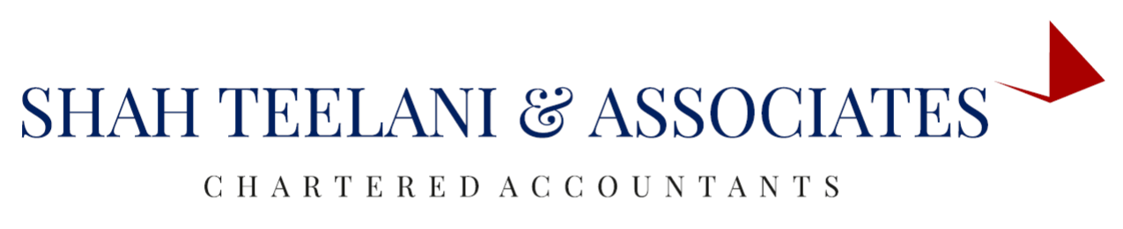

INDIAN ACCOUNTING STANDARD 2
INVENTORIES

Slide 2
OBJECTIVE
It Prescribe the accounting treatment of inventories.
It Deals with the determination of cost.
It determines Subsequent recognition as an expense, including any write-down to NRV.
Guidance on the cost formulas that are used to assign costs to inventories.

Slide 3
SCOPE
This standard applies to all inventories except:
Financial instruments (IND AS 32, financial instruments: presentation and IND AS 109, financial instruments)
(B) Biological assets (i.e. Living animals or plants) related to agricultural activity and
agricultural produce at the point of harvest (see IND AS 41, agriculture).
This standard does not apply to the measurement of inventories held by
Producers of agricultural and forest products, agricultural produce after harvest, and minerals and mineral products.
Commodity broker-traders who measure their inventories at fair value less costs to sell.

Slide 4
DEFINITIONS:
INVENTORIES
Inventories means asset :
i. Held for sale in the ordinary course of business,
ii. In the process of production for such sale; or
iii. In the form of materials or supplies to be consumed in the
production process or in the rendering of services.

Slide 5
2) Net realisable value
It is the estimated selling price in the ordinary course of business less the estimated cost of completion and the estimated costs necessary to make the sale.
In other words, NRV is the Net amount that an entity expects to realize from the sale of inventory in the ordinary course of business.
3) Fair value
It is the price that would be received to sell an asset or paid to transfer a liability in an orderly transaction between market participants at the measurement date.

Slide 6
MEASUREMENT OF INVENTORIES
AT THE LOWER OF
COST OF PURCHASE
NET REALISABLE VALUE

Slide 7
COST OF PURCHASES INCLUDES
PURCASE PRICE
IMPORT DUTIES AND OTHER TAXES
TRANSPORT HANDLING
OTHER COST TO BRING INVENTORY TO PRESENT LOCATION AND CONDITION
TRADE DISCOUNTS, REBATES AND OTHER SIMILAR ITEMS

Slide 8
COST OF CONVERSION
Cost of conversion of inventories includes costs directly related to the units of production such as:
Other direct costs
Direct Material
Direct Labour
Overheads

Slide 9
Other Costs
Other costs are included in the cost of inventories only to the extent that they are incurred in bringing the inventories to their present location and condition.
Costs to be excluded from the cost of inventories and recognized as expenses in the period in which they are incurred are:
Abnormal amounts of wasted materials, labour or other production costs,
storage costs, unless those costs are necessary in the production process
before a further production stage,
(c) administrative overheads that do not contribute to bringing inventories to
their present location and condition; and
(d) Selling costs.

Slide 10
Techniques for the measurement of cost
Retail method
Standard cost

Slide 11
RETAIL METHOD
Cost is determined by reducing the sales value of the inventory by the appropriate percentage gross margin. The percentage used takes into consideration inventory that has been marked down to below its original price. This method is often used in the retail industry for measuring inventories of rapidly changing items that have similar margins.

Slide 12
STANDARD COST METHOD
Cost is based on normal levels of materials and supplies, labour efficiency and capital utilisation. They are regularly reviewed and revised where necessary.

Slide 13
Cost of Inventory of Service Provider
They measure them at the costs of their production.
These costs consist primarily of the labour and other costs of personnel directly engaged in providing the service, including supervisory personnel, and attributable overheads.
Labour and other costs relating to sales and general administrative personnel are not included but are recognized as expenses in the period in which they are incurred.
The cost of inventories of a service provider does not include profit margins or non-attributable overheads that are often factored into prices charged by service providers.

Slide 14
DISCLOSURE
Accounting policies
the accounting policies adopted in measuring inventories.
2. Analysis of carrying amount
the total carrying amount of inventories and the carrying amount in
classification appropriate to the entity.
Common classifications on inventory are as follows:
Merchandise
Product supplies
Materials
Work in progress
Finished goods

Slide 15
DISCLOSURE
3. Inventories carried at fair value less cost to sell.
4. Amounts recognised in profit and loss
The amount of inventory recognised as an expense during the period.
The amount of any write-down of inventories recognised as an expense in the period.
5. Inventories pledged as security.

Slide 16
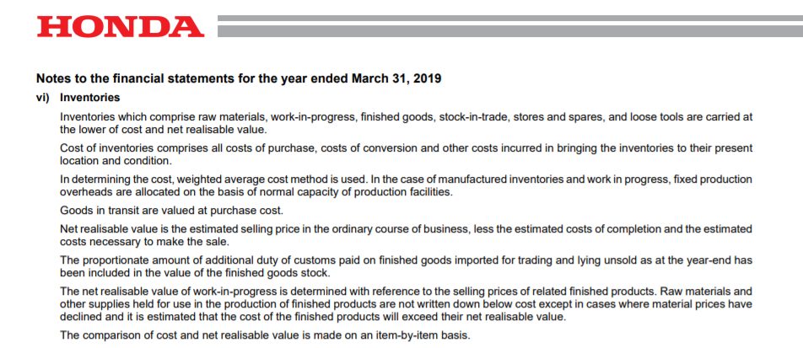
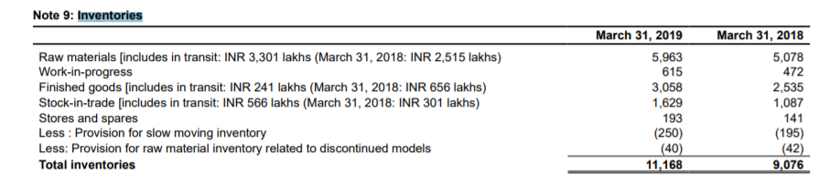
Inventory valuation data of HONDA

Slide 17
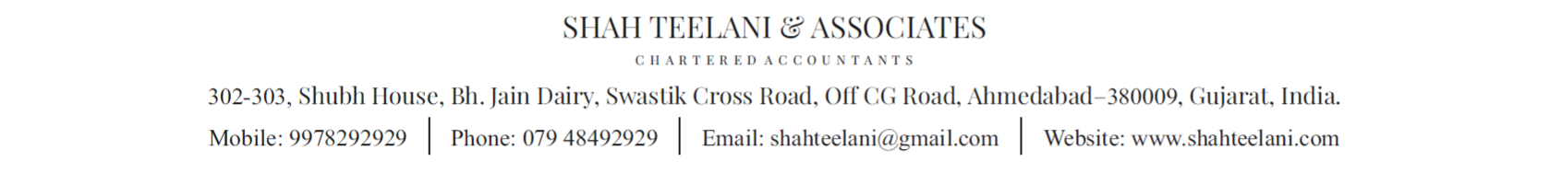
THANK YOU
PRESENTATION BY :- ADITYA CHANDNANI

