Slide 1
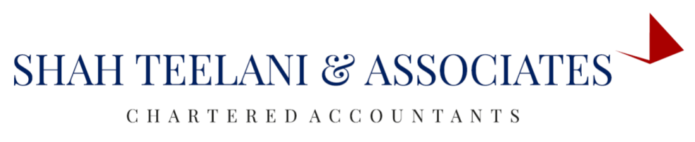

LONG TERM CAPITAL GAIN ON EQUITY SHARE CAPITAL
- By Prachi Motwani

Slide 2
Determination of Cost of Acquisition on or before 31st January, 2018
Cost of Acquisition means the actual cost of any asset acquired.
If the actual cost is less than the market value then fair market value will be deemed to be the cost of acquisition.
If the value of consideration or transfer is less than the fair market value then, such value of consideration or the actual cost whichever is higher will be deemed to be the cost of acquisition.

Slide 3
Determination of fair market value
In case of listed equity share or unit the fair market value(FMV) means the highest price of such share or unit quoted in the stock exchange on 31st January, 2018.
In case of no trading the FMV will be the highest price quoted on the immediately preceding date.
In case of Unlisted unit, The Net Asset value will be considered the Fair Market Value

Slide 4
Long-Term Capital Assets
Listed equity shares are considered as long-term capital assets if it is held for more than 12 months.
In the case of an unlisted equity share, the period of holding should be more than 24 months for qualifying as a long-term capital asset.

Slide 5
Cont…
Finance Act 2018 provides that Sec 10(38) will not be applicable to any income arising from the transfer of long-term capital asset, being
a) an equity share in a company or
b) a unit of an equity oriented fund or
c) a unit of a business trust,
made on or after the 1st April 2018

Slide 6
Amendments made by Finance Act 2018
A new Section 112A has been inserted, with effect from FY 2018-19 / AY 2019-20. This section is applicable if:
Total income includes any income chargeable under the head “Capital gains”
Capital gains arise from the transfer of a long-term capital asset being an equity share in a company or a unit of an equity oriented fund or a unit of a business trust
Securities transaction tax (STT) has been paid at the time of transfer, and also on acquisition in case of equity shares. (This condition shall not apply to a transfer undertaken on a recognised stock exchange located in any International Financial Services Centre and where the consideration for such transfer is received or receivable in foreign currency.)
Tax on such Long term capital gains shall be 10% on the gains exceeding Rs. 1 Lakhs.

Slide 7
Cont…
First and second provisos of Sec 48 shall not apply to the capital gains arising from the transfer of a long-term capital asset being an equity share in a company or a unit of an equity oriented fund or a unit of a business trust referred to in section 112A.

Slide 8
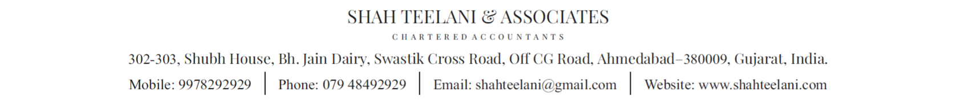
THANK YOU

