Slide 1

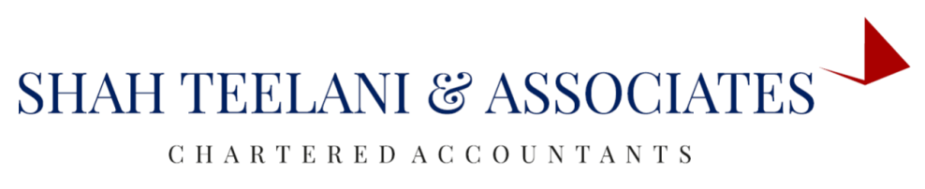

msme
BY DIVYA GOSWAMI
COMPANY SECRETARY

Slide 2
INTRODUCTION
MSME stands for Micro, Small and Medium Enterprises. In a developing country like India, MSME industries are the backbone of the economy.
The MSME sector contributes to
45% of India’s Total Industrial Employment,
50% of India’s Total Exports and
95% of all industrial units of the country
More than 6000 types of products are manufactured in these industries (As per msme.gov.in).

Slide 3
MSME Classification
MSME are classified into two categories:
i. Manufacturing enterprise; and
ii. Service enterprise.
Section 7 of the Micro, Small and Medium Enterprises Development Act, 2006 defines in term of investment in Plant and Machinery/ Equipment as below:
 | Micro | Small | Medium
Manufacturing Enterprises | Less than Rs 25 Lakhs | 25 Lakhs– 5 Crores | 5 Crores – 10 Crores
Service Enterprise | Less than Rs 10 Lakhs | 10 Lakhs – 2 Crores | 2 Crores – 5 Crores

Slide 4
MSME Schemes
Some of the MSME Schemes launched by the Government are:
Quality Management Standards & Quality technology Tools
Incubation
Credit Linked Capital Subsidy Scheme
Women Entrepreneurship

Slide 5
MSME Form 1 ROC Filing
MSME Form-1 (MCA) – 1ST May 2019 (MCA released E-form) is to be filed by those specified companies whose outstanding payment to MSMEs suppliers is exceeding 45 days.
The MSME Form-1 is to be filed for the payment of half yearly return with the Registrar of Companies (ROC) in respect of the outstanding payments to Micro or Small Enterprises.
The Ministry of Corporate Affairs have made major changes for protecting the interest of groups of small companies or business. He laid emphasis on following compliance by all Specified Companies Whether Public or a Private Company, Micro or Small.
The Companies who receive supply of goods or services from Micro or small enterprises and the amount of payment due with having the reasons of such delay, exceeds 45 days from the date of acceptance or date of deemed acceptance of the goods or services are required to file a half-yearly return.

Slide 6
MSME Form 1 ROC Filing
The Return should be state following points in it:
  amount of payment due; and
  reasons for the delayed payment
Specified Companies:
Specified companies as per the provisions of section 9 of the MSME Development Act, 2006 are those companies who receive the supply of goods or services from MSMEs and the payment against these supplies to the suppliers of these MSMEs exceed 45 days from the date of acceptance or date of deemed acceptance of the goods or services

Slide 7
MSME Form 1 ROC Filing
Day of Acceptance means:
(a) The day of the actual delivery of goods or the rendering of services; or
(b) Where any objection is made in writing by the buyer regarding acceptance of goods or services within fifteen days from the day of the delivery of goods or the rendering of services, the day on which such objection is removed by the supplier.
Day of Deemed Acceptance means:
Day of acceptance means the day of the actual delivery of goods or the rendering of services, where no objection is made in writing by the buyer regarding acceptance of goods or services within fifteen days from the day of the delivery of goods or the rendering of services.

Slide 8
MSME Form 1 ROC Filing
Micro and Small Enterprise: Any class or classes of enterprises (including proprietorship, Hindu undivided family (HUF), partnership firm, company, undertaking, co-operative society or an association of persons), in which are defined as MSME(s) under the Micro, Small and Medium Enterprise Development (MSME) Act, 2006.

Slide 9
Due Date for Filing MSME Form 1 (MCA)
Filing Period | Due date of Filing
From April to September | 31st October
From October to March | 30th April

Slide 10
Exemption to this rule-Who should not file the form?
This Rule is not applicable for all the Companies but only for those Specified Companies whose dues to MSMEs suppliers exceed 45 days from the date of acceptance or deemed acceptance of the goods or services under the provisions under section 9 of the MSME Development Act, 2006.
If the payment against supplier exceeds 45 days but the supplier/Creditors gives a declaration that they do not fell under the category of Micro or small Enterprises.

Slide 11
Penalty
A failure to comply with the Order, shall attract a fine which is extendable to twenty-five thousand rupees. Further, any officer in default of the Specified Company shall be punishable with imprisonment which can extend to a period of six months or fine which can extend to three lakhs rupees, but not less than twenty-five thousand rupees or both. If the payment against supplier exceeds 45 days but the supplier/Creditors gives a declaration that they do not fell under the category of Micro or small Enterprises.

Slide 12
Conclusion
The introduction of MSME-1 is another initiative by the present government to strengthen the micro and small enterprises by prescribing a mandatory filing regime twice a year by their large customers.

Slide 13


Examples of MSMEs
Different Handicrafts of India

Slide 14

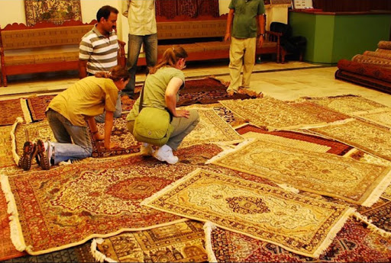

Examples of MSMEs
Rugs Factory -Jaipur

Slide 15
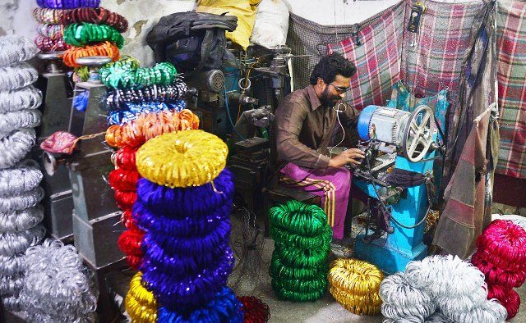
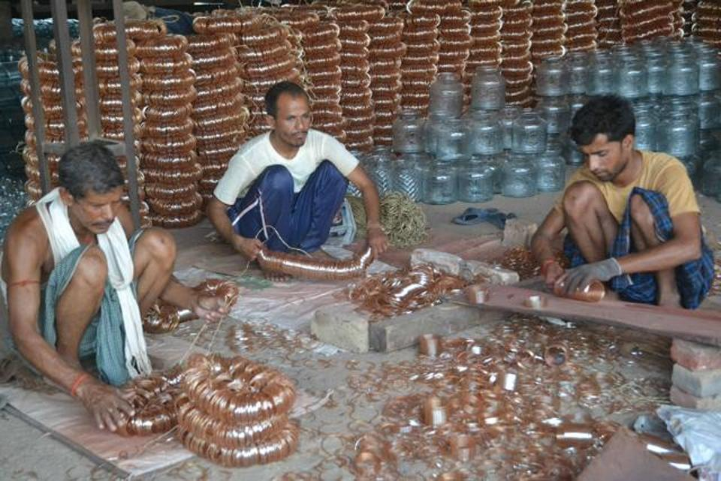
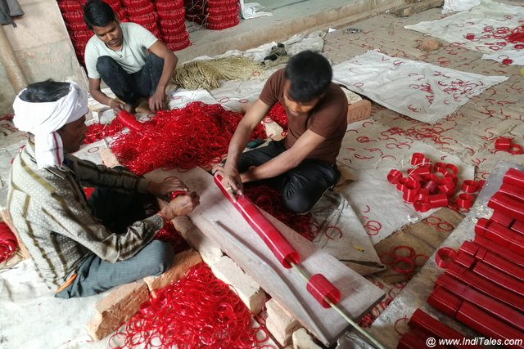
Examples of MSMEs
Rugs Factory -Jaipur

Slide 16
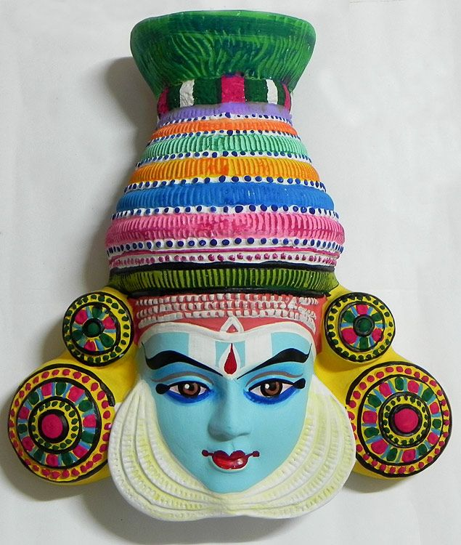
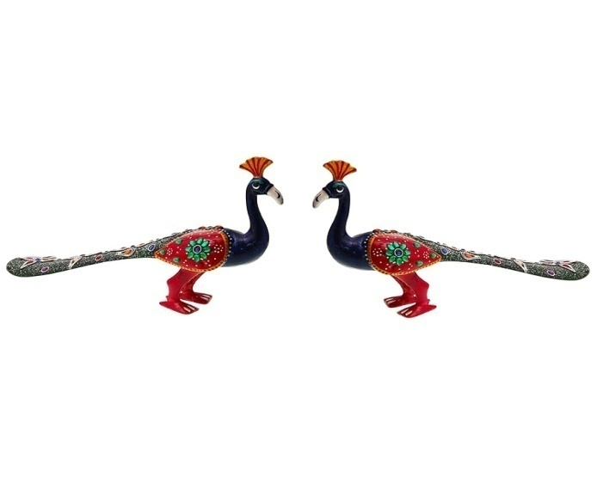
Examples of MSMEs
Paper Mache Small Enterprise

Slide 17


