Slide 1


Slide 2

Meaning of Private Company
Section 2(68) of Companies Act, 2013 defines private companies.
According to that, private companies are those companies whose articles of association restrict the transferability of shares and prevent the public at large from subscribing to them.

Slide 3
Features Of Private Limited Company
Minimum 2 and maximum 200 members
“Private Limited”: All private companies must include the words “Private Limited” or “Pvt. Ltd.” in their names.
Members Liability is Limited
Restrictions on shares Transferability
Separate legal entity

Slide 4
Moving from the Companies Act- 1956 to the Companies Act 2013 is like shifting from our old house to a new one. All the provisions become changed with new Act, 2013. Due to new act many amendments were introduce by Central Government from time to time by Notification, Amendments etc. Same like this many amendments have been made in last approximately 5.5 years in relation to Incorporation of New Company
DATE | JOURNEY SO FAR
01/04/2014 TO 30/04/2015 | New forms for Incorporation Company Introduced i.e. INC-1 – Name Approval; DIR-3 – Director Identification Number INC-7 – Incorporation of Company DIR-12 – Appointment of Directors INC-22 – Registered Office of Company
01/05/2015 TO 30/09/2016 | Integrated Incorporation Process in form INC-29. This form was 5 in one form. Company could apply DIN, Name, Appointment of Director, Registered Office and Incorporation in single form with lesser ROC Fees. Still there was some restriction in INC-29.
01/10/2016 TO 26/01/2018 | Through Companies (Incorporation) Fourth Amendment Rules, 2016 a new form “SPICE” i.e. INC-32 (Specified Performa for Incorporation Company Electronically). This form was one step ahead to INC-29. E.g. Electronic MOA & AOA introduced in this Form. However, Company having both the way they can apply name in SPICE or apply name in INC-1 then can file Spice. PAN & TAN application become mandatory as part of the SPICE.

Slide 5
26/01/2018 | This Date is revolutionary in the History of Companies Act for the purpose of “EASY OF DOING BUSINESS”. Following Alteration made by Central Government: i. New Process of Name Approval “RUN” notified and e-form INC-1 omitted. ii. INC-7 form omitted. Only way out for incorporation of Company is SPICE. iii. No ROC fees for Incorporation of Company up to 10 lack of authorized capital. iv. Updated version of SPICE notified.
Another Alteration | Except the above mentioned amendment some other amendments have been made since 01.04.2014 to till date e.g. 1.No Requirement of Minimum Paid up share Capital. 2.Only one form for Incorporation of Company. 3.E-MOA & AOA

Slide 6
DETAILS AND DOCUMENT REQUIRED
Address of Registered office of the Company.
Phone & E-mail id of the Company
Details of Directors
Authorized Share Capital of the Company
Latest Electricity Bill of registered office of the Company
Rent Agreement, if office is on Rent
Proof of Directors:
1. PAN Card
2. Voter Identity Card/Passport/Driving License
3. Bank Statement/Electricity Bill/Telephone Bill/Mobile Bill (It should be in the name of the Director and not older than 2 Months)

Slide 7
STEPS FOR THE INCORPORATION OF PRIVATE COMPANY UNDER COMPANIES ACT-2013
Reservation of Company Name:
First the applicants required to apply for name on MCA portal (RUN Reserve Unique Name). The fees for seeking a name approval is 1000/-as prescribed and 20days are allowed for incorporating the company. The name of the company should not be undesirable i.e. identical to existing company.
The Applicant will receive intimation from the Registrar of Companies within 2 or more working Days.
Application for Registration of Company:
Various Forms Are Required for application for Registration of company .That are described as under.

Slide 8

FORMS
FORMS :
Applicant can download form from the MCA portal
Following 4 forms Required:
1.Spice
2.Spice-MOA
3.Spice-AOA
4.AGILE

Slide 9

Attachments Required in form Spice
1.Declaration of the First subscriber to MOA and AOA (which includes of following)
INC-9
DIR-2( consent to Act as director only if subscriber is
director of proposed Company)
Identity and Residential proof of Directors
2.Proof of office Address
3.Utility Bill

Slide 10

Form –Spice MOA (Clause)
Name Clause
Registered Office Clause
Objects or Objective Clause
Liability Clause
Capital Clause
Association Clause

Slide 11

FORM- Spice AOA(Clause)
Articles of Association(AOA) of a Company generally contains provisions/ rules and regulation relating to the management of the Company. The Contains of AOA differs from company to company, which is as per the form prescribed under the companies act 2013.

Slide 12
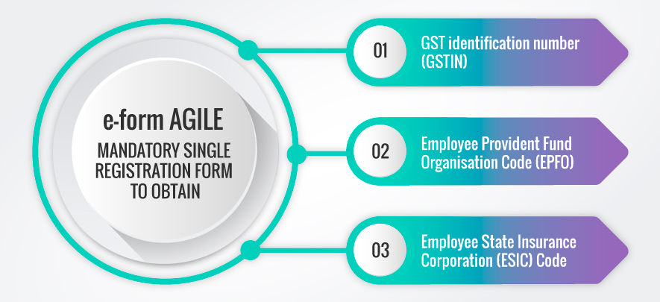

Slide 13
Others:
As Per CA ACT-1949
A practicing Chartered accountant can become a director of a company.
Previously clause 11 part 1 first schedule Of The CA Act 1949 restricts that practicing CA can't be a MD/WTD. But now relaxation has been given. He can become a MD/WTD with specific permission from the CA council.
He must comply with conditions stipulated for appointment of director as per the Companies Act 2013.

Slide 14
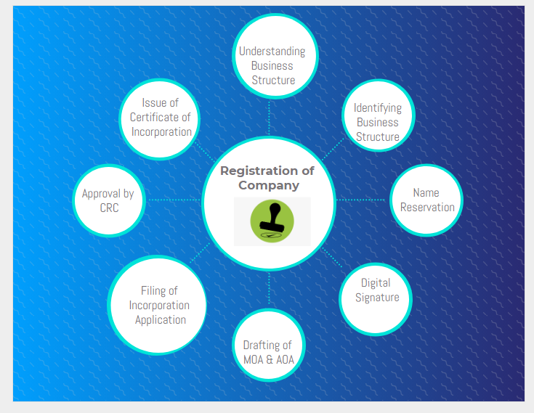

Slide 15
FOR ANY CORPORATE SOLUTION PLEASE CONTACT SHAH TEELANI & ASSOCIATES
THANKING YOU

