Slide 1
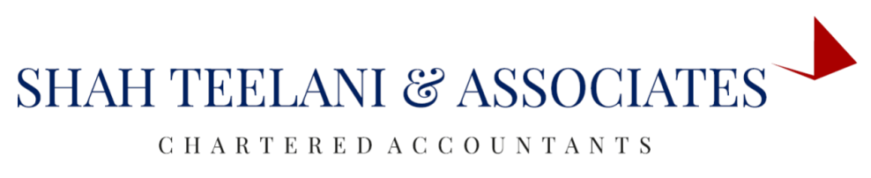

IND AS 102
SHARE BASED PAYMENTS
BY: JAYESH AHUJA
ARTICLE ASSISTANT

Slide 2
DEFINATION
A transaction in which an entity
Receives goods and services from suppliers (including employees) and in consideration issues equity instruments(including options
Receives goods and services from suppliers (including employees) by incurring a liablity based on the price of shares

Slide 3
SCOPE
IND AS 102 does not covers the following
Shares issued to employees in the capacity of the employees. For eg: right shares and bonus shares issued to employes
Shares issued for acquiring net assets in a business combination(IND AS 103)
Transactions covered under IND AS 109 (features of derivative instruments)

Slide 4
TYPES
TYPES OF SHARE BASED PAYMENTS
Equity settled share based payment
Cash settled share based payment
Share based payment with alternative of taking either cash or shares

Slide 5
SOME IMPORTANT TERMS
GRANT DATE : It is the date on which employees agree to the terms and conditions of a share based payment plans
NOTE: If the share based payment plan with employees requires approval of the shareholders then the date of passing the resolution would be taken as grant date
Vesting conditions : These are the service or performance conditions which employ has to satisfy in order to become eligible for subscription to the shares
Vesting period : It is the period from the grant date till the date when the vesting conditions are satisfied
Exercise period : It is the period given by the company to its employees to subscribe to the shares
NOTE : At the end of the exercise period , the remaining shares which are not subscribed by employees becomes lapsed

Slide 6
VESTING CONDITIONS
PERFORMANCE CONDITIONS
MARKET BASED CONDITIONS
Eg: Share price should reach above 1000
OTHER PERFORMANCE CONDITIONS
Eg: PAT should be atleast 5 crore
SERVICE CONDITIONS
BASIC CONDITION OF SERVICE
Eg: Remain in service for 4/5/6 years

Slide 7
EXAMPLE
ABC limited granted to its employees share options with fair value of Rs 5,00,000 on 1st APRIL 2010, if they remain in organization upto 31st March 2013. On 31st Mar 2011 ABC limited expects only 91% of the employees to remain in the employement. On 31st Mar 2012 company expects 89% of the employees to remain in the employment. However 82% of the employees remained in the organization at the end of the 31st Mar 2013 and all of them exercised their options. Show allocation of the expenses in each year and necessary journal entries.
PERIOD | PROPORTION | FAIR VALUE | TO BE VESTED | CUMULATIVE EXPENSES | EXPENSES
Period 1 | 1/3 | 5,00,000 | 91% | 1,51,667 | 1,51,667
Period 2 | 2/3 | 5,00,000 | 89% | 2,96,667 | 1,45,000
Period 3 | 3/3 | 5,00,000 | 82% | 4,10,000 | 1,13,333u

Slide 8
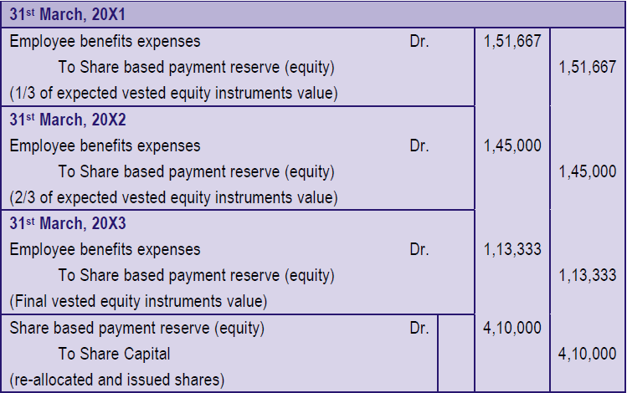
JOURNAL ENTRIES

Slide 9
CASH SETTLED SHARE BASED PAYMENTS
ALSO KNOWN AS “SARS”(STOCK APPRECIATION RIGHTS
It is possible that the company doesnot want to dilute its stake by issuing shares, hence in this case, the company would pay cash to its employees based on the market price of the shares

Slide 10
MODIFICATION OF SHARE BASED PAYMENTS
If there is any modifications to the terms and conditions on which the equity instruments were granted, or a cancellation or settlement of that grant of equity instruments, the entity should recognise, as a minimum, the services received measured at the grant date fair value of the equity instruments granted, unless those equity instruments do not vest because of failure to satisfy a vesting condition (other than a market condition) that was specified at grant date. In addition, the entity should recognise the effects SB-FRS 102 30 of modifications that increase the total fair value of the share-based payment arrangement or are otherwise beneficial to the employee.

Slide 11
CANCELLATION OF SHARE BASED PAYMENTS
If the Share Based Payment is cancelled then the employees compensation expenses should be recognized entirely in the reverse vesting period.
For eg: Vesting period was 3 years and cancellation took place in the 2nd year then the revised vesting period would be 2 years and the amount which is recognized in 3rd year would be recognized in 2nd year.
It is possible that company has paid cash to its employees on the cancellation,then it would be treated repurchase of equity interest to the extend of the fair value of the option on the date of cancellation,any excesss over the fair value would be treated as an expense

Slide 12
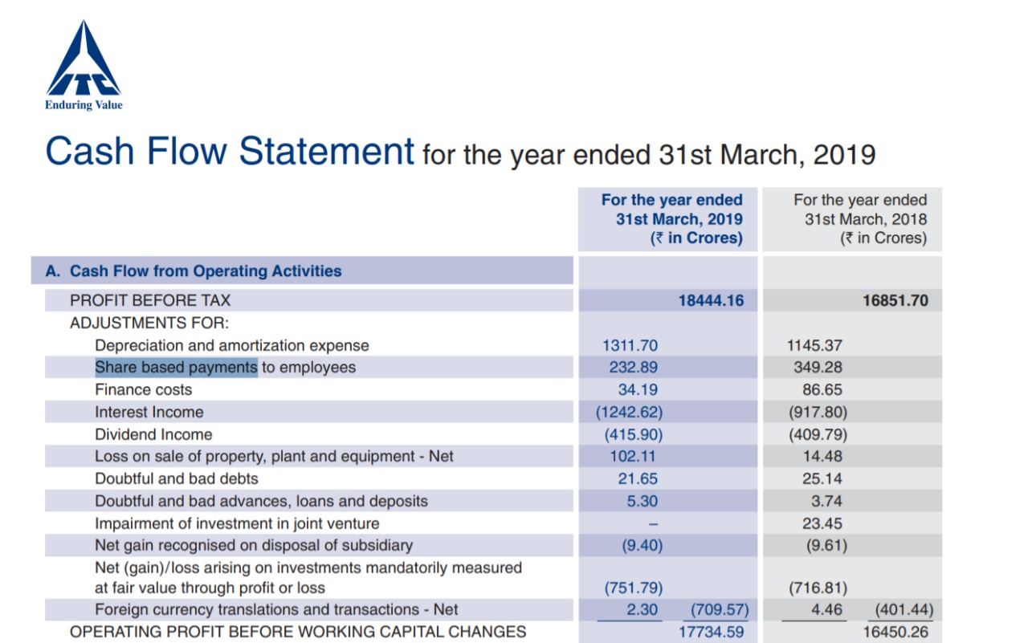
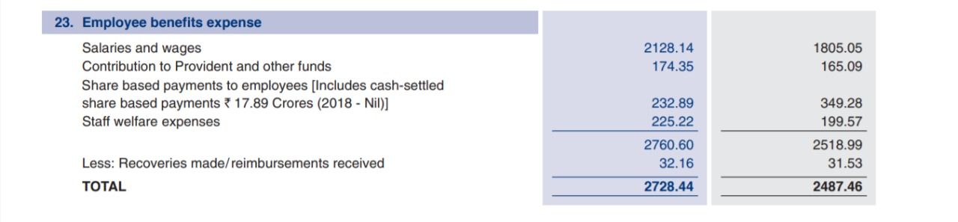

Slide 13
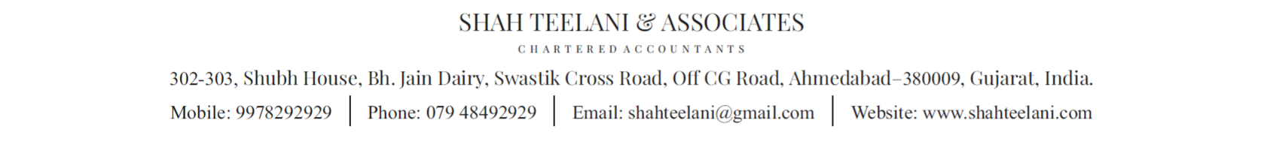
THANK YOU
JAYESH D AHUJA
ARTICLE ASSISTANT
ANY QUESTIONS ?

