Slide 1


Taxes on Income (AS 22)
By ANAND GORATELA

Slide 2
Definitions
Accounting income / loss : The net profit for a period as reported in the statement of profit and loss before deducting income tax expenses. In common terms, profit before tax.
Tax expenses / (tax savings) as per the books of accounts : The agreement of current tax and deferred tax charged or credited to the statement of profit and loss for the period
tax expenses = current tax + deferred tax.
Taxable income: The amount of income for a period determined in accordance with the tax laws, based upon which income tax payable is determined tax calculated as per it act.
Current tax : the amount of income tax determined to be payable in respect of the taxable income for a period as per the income tax laws or the tax computed on taxable income, which is payable in the period.

Slide 3
Accounting income and taxable income for a period are seldom the same.
Difference between the two are on account of:
- Permanent difference
- Timing difference
Taxes on Income

Slide 4
Timing difference
  Temporary in nature
  Difference will get reversed in a matter of time
Permanent difference
  Permanent in nature
  Difference will never get reversed

Slide 5
Example of Timing Difference
Expenditure covered by section 43B of income tax act
Expenditure deffered in accounts but allowed fully for tax purposes in the year of accurance
Provision made in accounts but allowed for tax purposes only when liabilities actualy crystallise in a sunsequent year
Difference in depreciation charge due to depreciable amount, depreciation rate method, or manner of calculating depreciation.

Slide 6
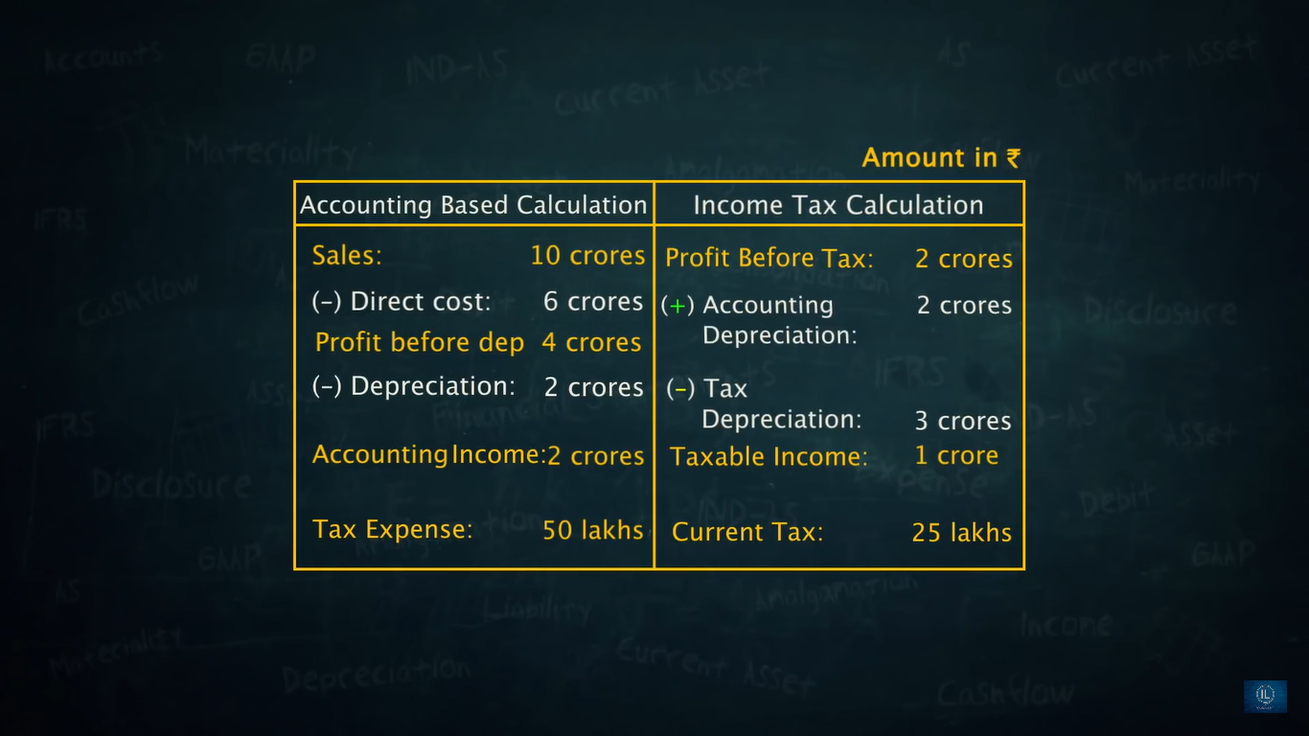

Slide 7
Profit before tax
Taxable income
Difference
Timing difference
Permanent difference
Difference*tax rate = deffered tax
ignore

Slide 8
Which rate is to be taken while calculating deffered tax asset or deffered tax liability?
Substantively annacted tax rate
When you are dealing with the deffered tax ignore the time value of money

Slide 9
Conditions for set off
There are basically two conditions for set off
  Intention to set off
  Legally permissible
Legally permissible means indian deffered asset can not set off against USA differed liablity

Slide 10
THANK YOU

