Slide 1
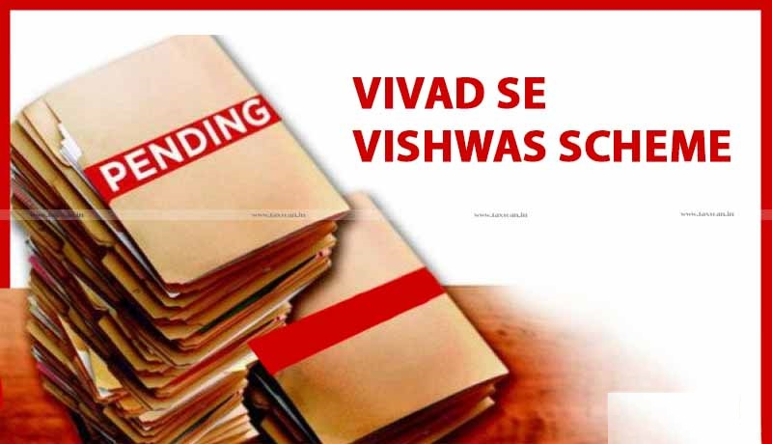
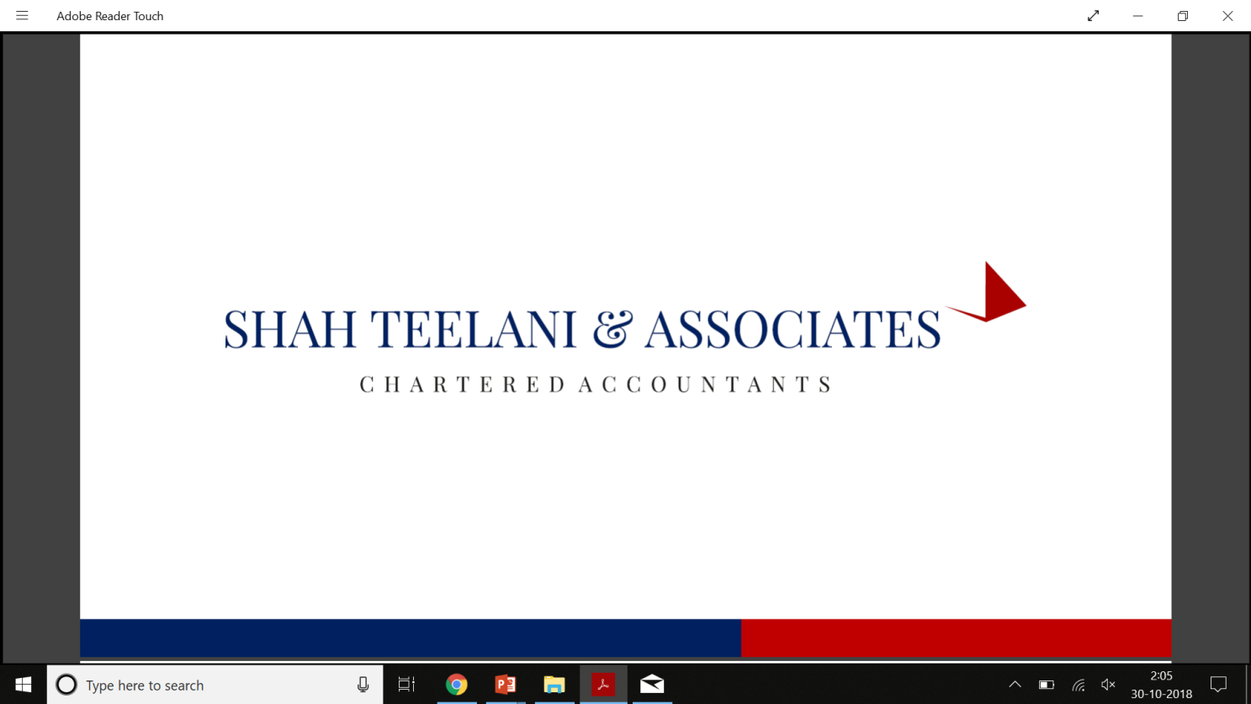

ENTER TITLE HERE
ENTER SUB TITLE HERE

Slide 2
Why DTVSV Act 2020 ?
The 'Vivad se Vishwas' Scheme was announced During the Union Budget. 2020 presentation.
Act of Parliament received the assent of the President on the 17th March, 2020.
Dispute resolution in respect of pending income tax litigation.
Timely revenue for the Government
Benefit taxpayers by paying Disputed Tax and get waiver from Interest and Penalty.
Savings on account of time and resources that would otherwise be spent on the long-drawn and vexatious litigation process.

Slide 3
Walkthrough
What is DTVSV Act 2020 ?
Eligibility
Payment terms
Exclusion
Forms
Salient features

Slide 4
THE DIRECT TAX VIVAD SE VISHWAS ACT, 2020
Inspired by the success of the Sabka Vishwas Scheme, which reduced several indirect tax disputes, the Finance Minister tabled The Direct Tax Vivad se Vishwas Bill, 2020 in Parliament on February 5, 2020.
An Act to provide for resolution of disputed tax and for matters connected therewith or incidental thereto.
How individuals can settle their income tax disputes applicable to all appeals/petitions filed by the taxpayers or the income tax department, which were pending until 31 January 2020, before any appellate forum.
It offers a complete waiver on interest and penalty to the taxpayers who pay their disputed taxes on or before March 31, 2020.
To widen the scope of the scheme, certain amendments to the Bill were proposed to the Parliament on February 14, 2020. The amended Bill was passed by the lower house of the Parliament on March 04, 2020 and from Upper house on March 13, 2020.
Payment of Disputed to made by 31st March 2020. After this date and before closure of scheme the payment shall be at higher rate.

Slide 5
Eligibility
In case of all pending appeals before CIT(A), ITAT, High Court and Supreme Court as on 31st January, 2020.
Order for which time for filing appeal has not expired on or before 31.01.2020
Case pending before Dispute Resolution Panel (DRP) on or before 31.01.2020
Cases where DRP issued direction on or before 31 Jan 2020 but order has not yet been passed.
Revision Application pending before CIT under section 264 on or before 31.01.2020

Slide 6
Eligibility
Disputed tax can also include the tax determined on default in respect of tax deducted at source (TDS) or tax collected at source (TCS).
Disputed tax shall include tax on enhancement notice
Appeals may be against Dispute Tax, Interest ,Penalty , fees and TDS and TCS

Slide 7

Payment Terms
Payment Made on or Before | Made Till 31/03/2020 | Made after 31/03/2020
Appeal, writ, SLP, arbitration relates to disputed tax . | 100% of the disputed tax[waiver of interest & penalty ] | 110% of the disputed tax [waiver of interest & penalty ]
Appeal, writ, SLP, arbitration relates only to disputed penalty or interest or fee. | 25% of the disputed penalty or interest or fee | 30% of the disputed penalty or interest or fee
Appeal, writ, SLP, arbitration relates to disputed tax in search cases. | 125% of the disputed tax[waiver of interest & penalty ] | 135% of the disputed tax[waiver of interest & penalty ]
* As a relief measure relating to Statutory and Regulatory compliance matters across Sectors in view of COVID-19 outbreak Vivad se Vishwas scheme – no additional 10% amount, if payment made by June 30, 2020

Slide 8
Exclusions
Search cases if disputed tax is more than Rs. 5 Crore.
Prosecution cases under the Income-tax Act or IPC filed by the Department.
Cases relating to undisclosed foreign income and assets.
Relating to an assessment or reassessment made on the basis of information received under an agreement referred to in section 90 or section 90A of the Income-tax Act.
Cases where person is notified under Special Courts(Trial of Offences Relating to Transactions in Securities) Act, 1992 or detained under Conservation of Foreign Exchange and Prevention of Smuggling Activities Act, 1974.
Cases covered under Narcotic Drugs and Psychotropic Substances Act, Unlawful Activities (Prevention) Act, Prevention of Corruptin Act, Conservation of Foreign Exchange and Prevention of Smuggling Activities Act, Prevention of Money Laundering Act, Prohibition of Benami Property Transactions Act.

Slide 9
Forms
Declaration
To be file online on the E-filing portal.
Form 1 is bifurcated into 6 parts consist of Part A to F where information relating to eligibility , related to dispute ,tax arrears , amount payable ,amount paid and net to be paid or refunded .
Undertaking
Whereby whereby the taxpayer waives all rights to any remedy/claim related to the matter for which the taxpayer opts to settle his disputes under the VsV Act.
Granting of certificate
The designated authority shall grant a certificate electronically to the declarant containing the particulars of the tax arrears and the amount payable in this form. The declarant is required to pay the amount payable as mentioned in Form 3 within the prescribed time; otherwise, the declaration under Form 1 shall be treated as null and void.
Form 1
Form
2
Form 3

Slide 10
Forms
Intimation of payment and proof of withdrawal
The details of payment made pursuant to Form 3 shall be furnished to the designated authority in this Form.
. Further, the proof of withdrawal of appeal, objection, application, writ petition, special leave petition, arbitration, conciliation, mediation, or claim filed by the declarant (as the case may be) shall also be furnished.
The order is a culmination of the entire process whereby the designated authority certifies that the taxpayer has paid the dues as mentioned in Form 3 and that immunity from any prosecution or penalty proceedings is granted to the taxpayer.
The designated authority in this Form shall issue the order.
Issuance of order
Form
4
Form
5

Slide 11
Salient Features
Consequent to such declaration and on fulfillment of conditions, all appeals, writs, SLPs, arbitration to be withdrawn (both by taxpayer and by department).
Immunity from initiation of proceedings in respect of offence and imposition of penalty in certain cases and waiver of Interest and fees.
No refund of amount paid. Provided If the amount paid by the taxpayer before filing declaration exceeds the amount payable under the Scheme, he would be granted the refund for such excess amount.
If an issue in taxpayer’s pending appeal already decided in favor of taxpayer by higher appellate forum or if Department has filed appeal, amount payable is 50% of aforesaid amounts.
If there are more than one issues involved in the appeal, the taxpayer would be required to file declaration for all issues, he cannot file declaration for some issues and litigate the balance issues.
The designated authority shall, within a period of fifteen days from the date of receipt of the declaration determine the amount payable by the declarant and grant a certificate.
The declarant shall pay the amount determined by designated authority within fifteen days of the date of receipt of the certificate.

Slide 12
Salient Features
Where the dispute in relation to an assessment year relates to reduction in loss or unabsorbed depreciation or MAT credit to be carried forward under this Act, the declarant shall have an option to do the following:
Pay tax on the disputed amount without reducing the amount of loss or unabsorbed depreciation or MAT credit; or
Carry forward the reduced amount of loss or unabsorbed depreciation or MAT credit

Slide 13
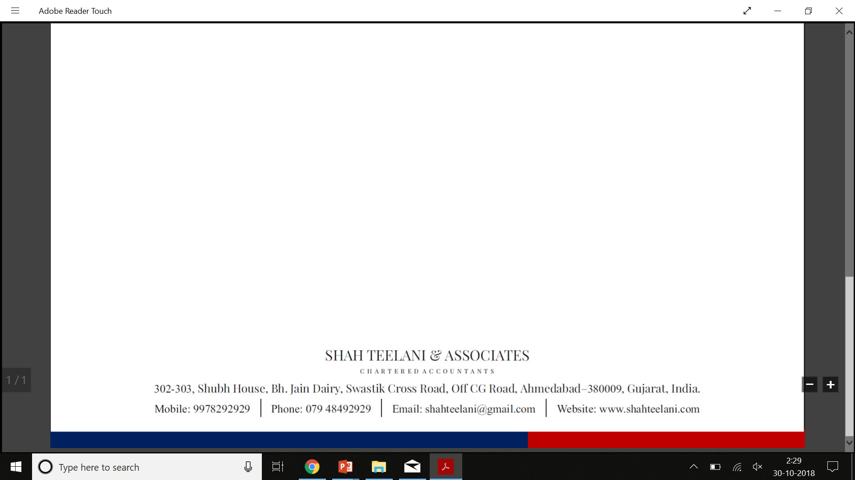
THANK YOU

